Slide 1

Data Analysis for: Diabetic Prediction
Our great team members: (Alphabetically ordered)
Azeez Odekunle
Bertrand Vernyuy Ndzewiyi
Fatemeh Fakhredin
Olha Hnatenko
Rasheed Odunbaku

Slide 2

Agenda:
Discover the dataset
Data cleaning
Descriptive analysis
Data visualization
Outliers
Statistical analysis
Classification algorithms
Conclusion

Slide 3

Let’s Discover our Dataset

Slide 4
About Dataset: Context: This dataset is originally from the National Institute of Diabetes and Digestive and Kidney Diseases. The objective is to predict based on diagnostic measurements whether a patient has diabetes. Content: Several constraints were placed on the selection of these instances from a larger database. In particular, all patients here are females at least 21 years old of Pima Indian heritage. Source: https://www.kaggle.com/datasets/akshaydattatraykhare/diabetes-dataset

Slide 5
Columns | Description
Pregnancies: | Number of times pregnant
Glucose: | Plasma glucose concentration a 2 hours in an oral glucose tolerance test
BloodPressure: | Diastolic blood pressure (mm Hg)
SkinThickness: | Triceps skin fold thickness (mm)
Insulin: | 2-Hour serum insulin (mu U/ml)
BMI: | Body mass index (weight in kg/(height in m)^2)
DiabetesPedigreeFunction: | Diabetes pedigree function
Age: | Age (years)
Outcome: | Class variable (0: Non-diabetic or 1: Diabetic)
Pregnancies_status: | Changing number of pregancies to a binary variable in a new column. Where any pregnancy > 0 is returned a value of 1, otherwise 0.
BMI_Categories: | Categorizing BMI in 4 groups of: Obesity, Overweight, Health weight and Underweight
Age_Categories: | Categorizing Age in 4 groups of: Old, Senior, Adult, and Young

Slide 6

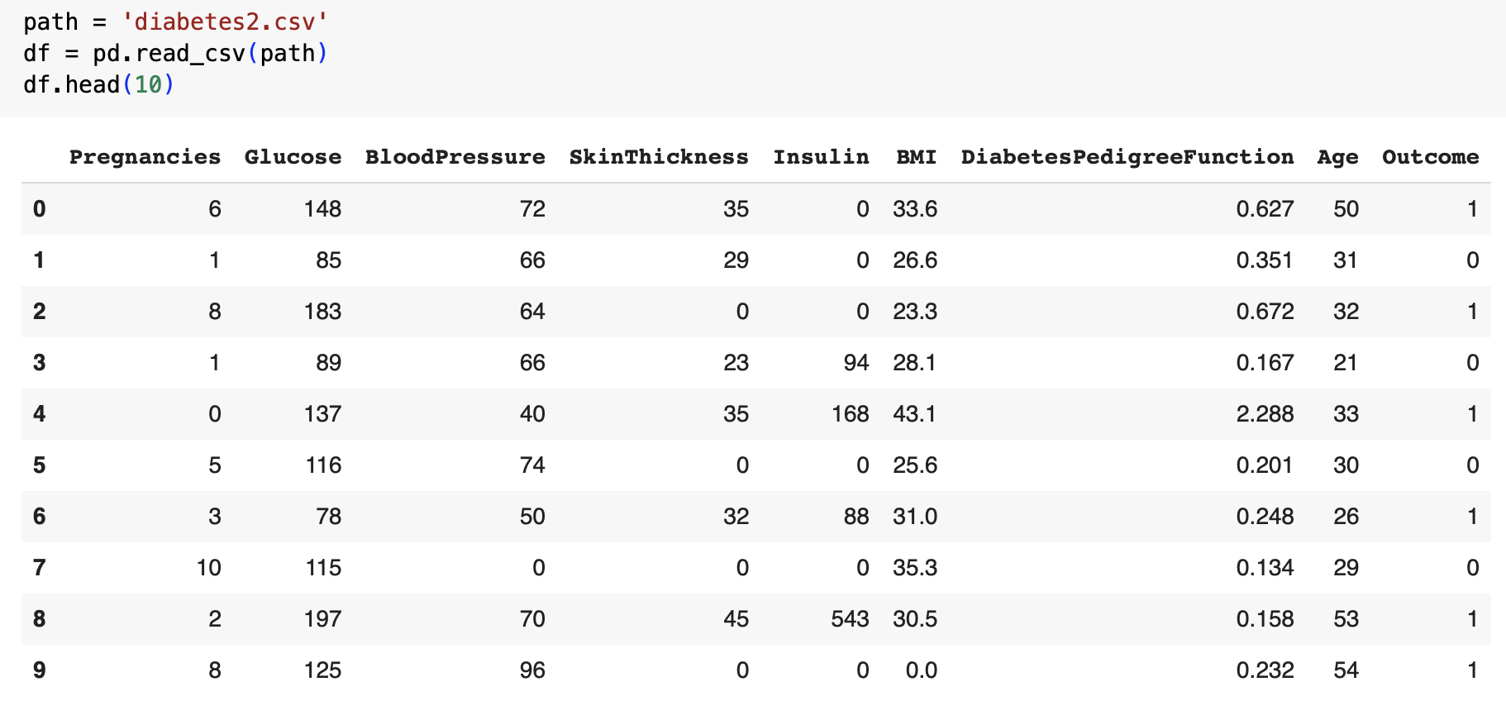
Overview of Dataset:
Pandas??? ☺
768 rows
9 initial columns

Slide 7

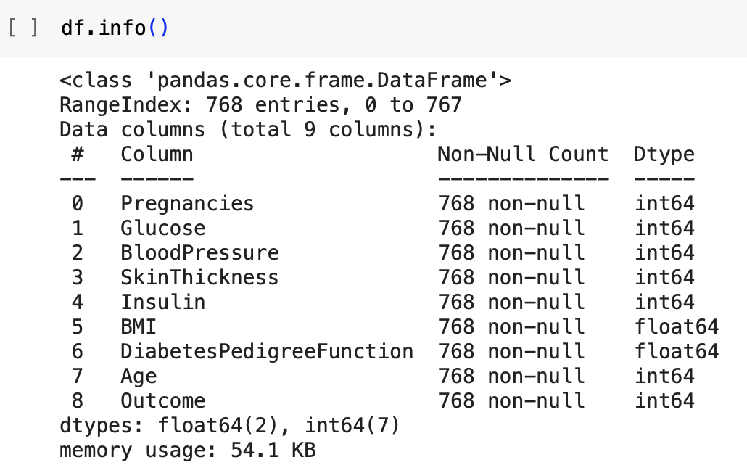

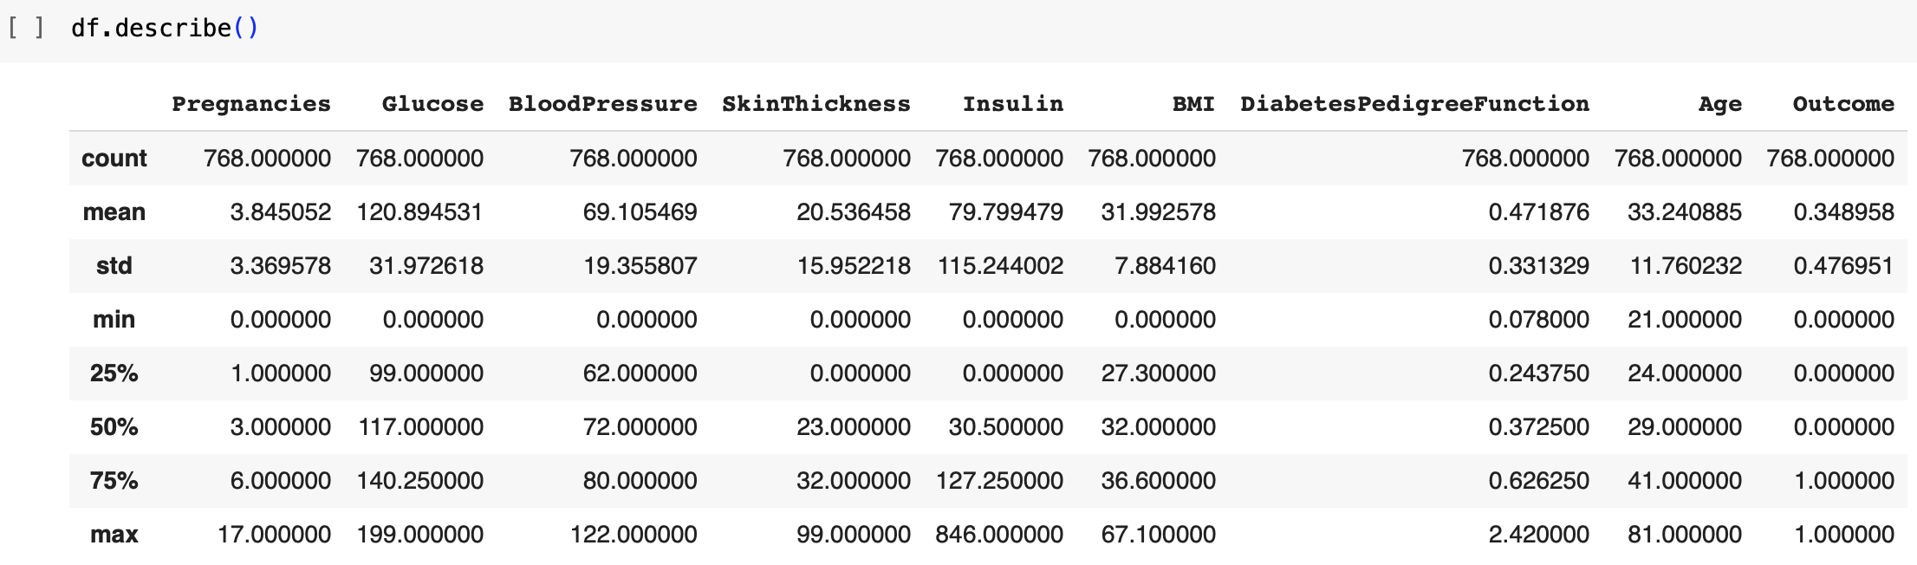
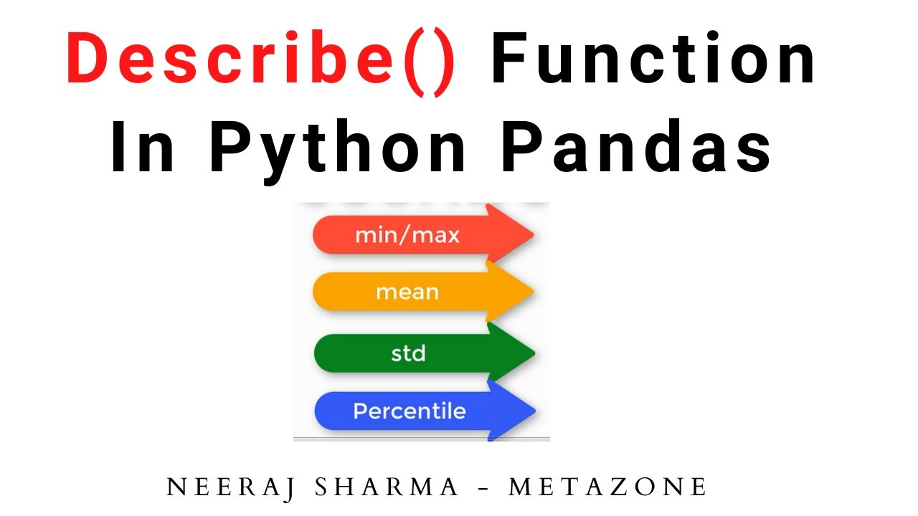
Let’s Discover Our Dataset:

Slide 8

Data Cleaning

Slide 9
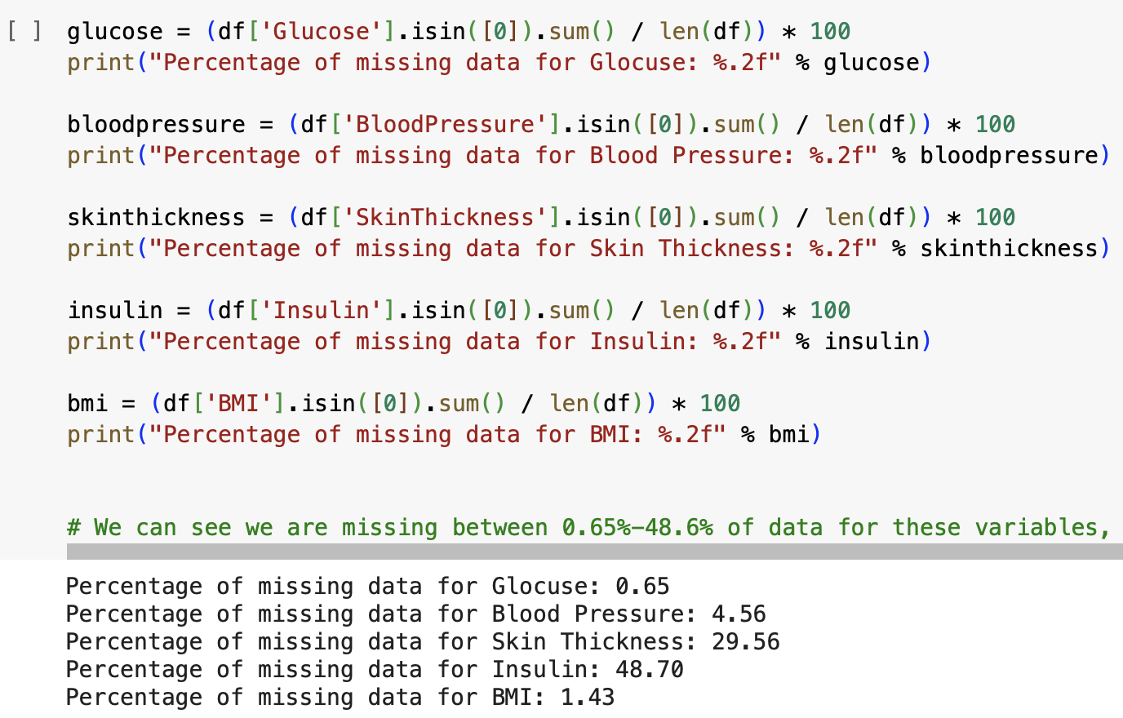
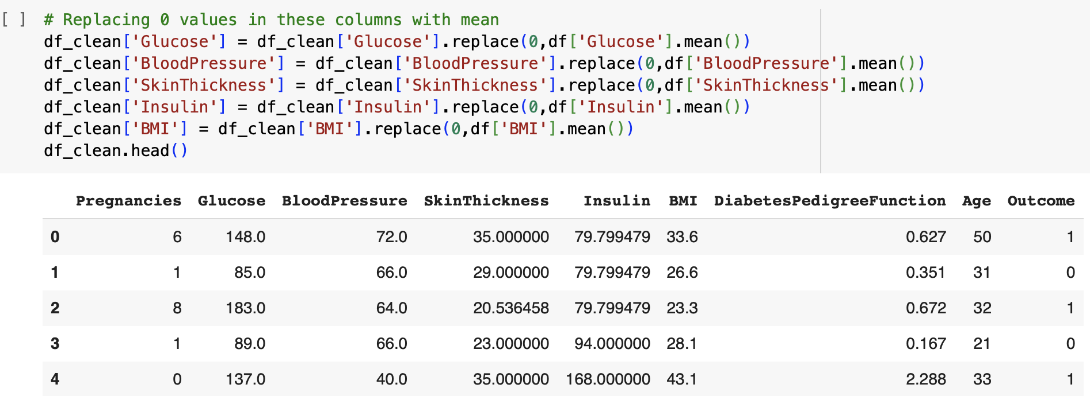
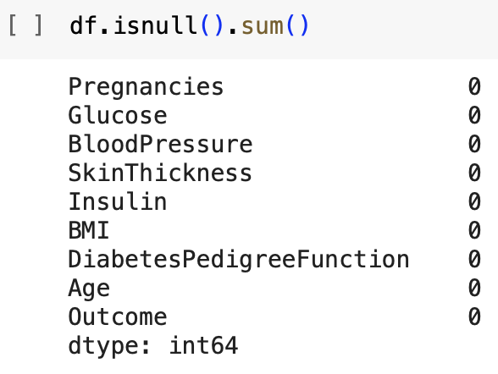
Missing-Value Handling:
We can see we are missing between 0.65%-48.6% of data for these variables, even though the isnull function showed us no missing data as NaN.
So, we replaced 0 values in these columns with the mean.

Slide 10

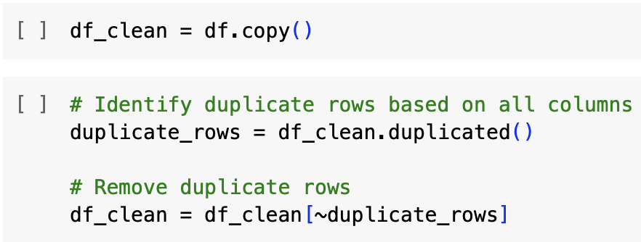
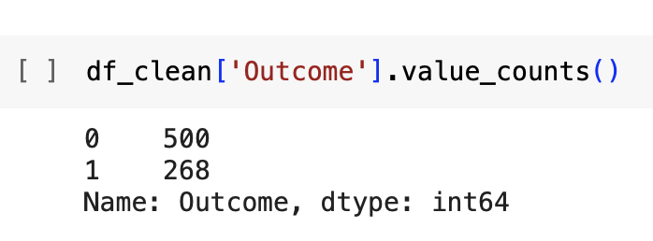
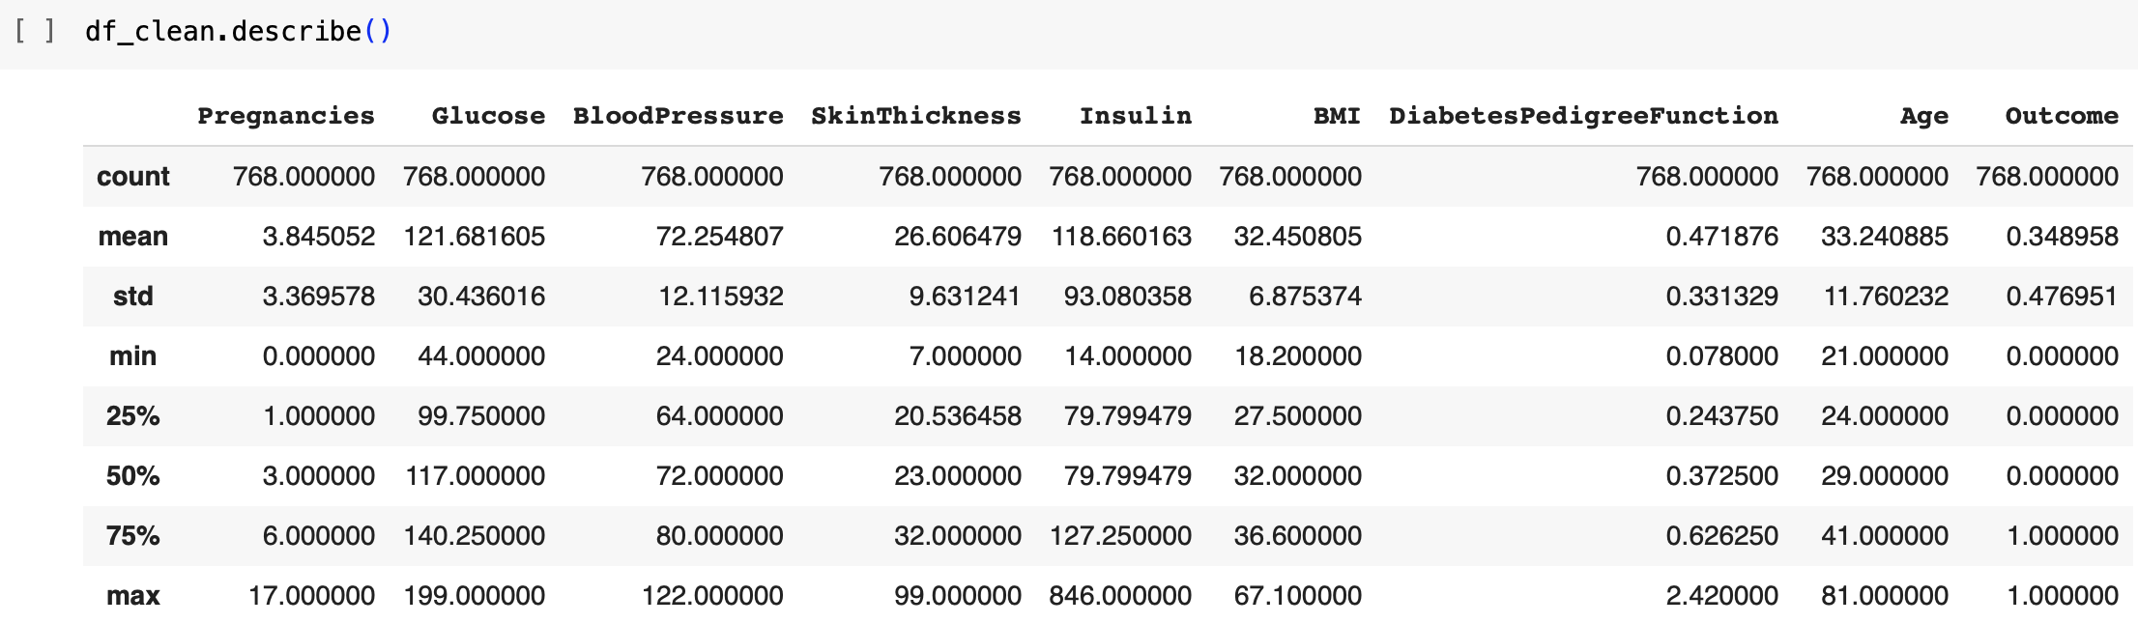
Data Cleaning:

Slide 11
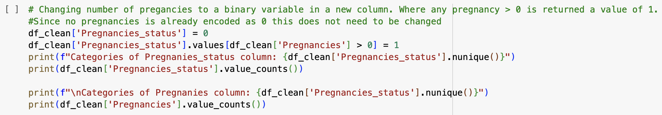
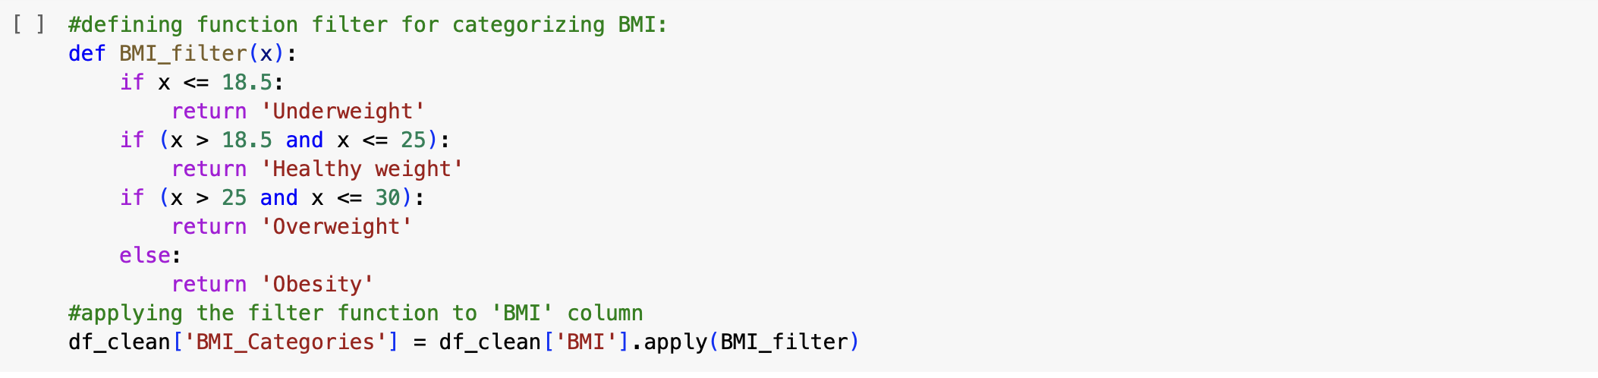
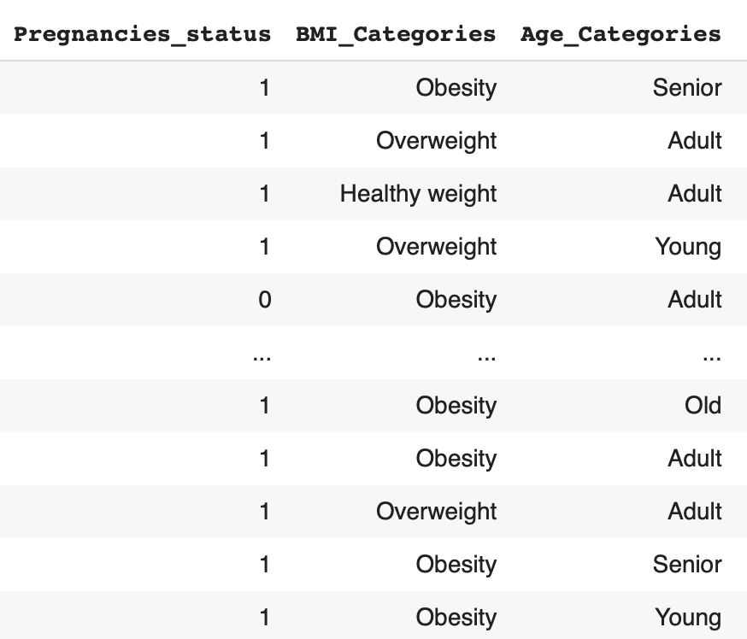
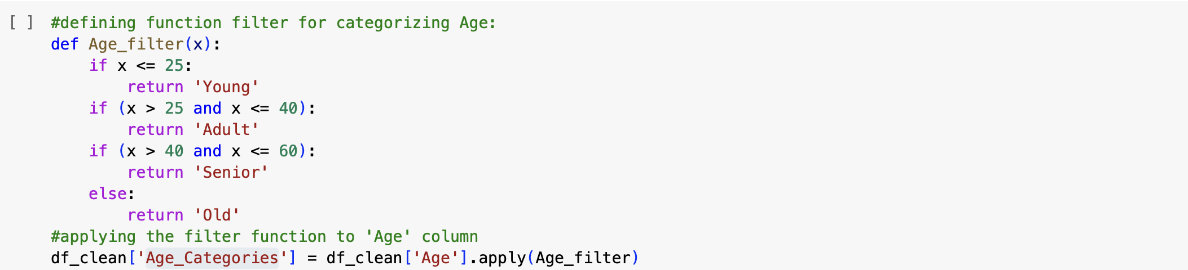
Defining New Qualitative Columns:
Pregnancies_status
BMI_Categories
Age_Categories

Slide 12
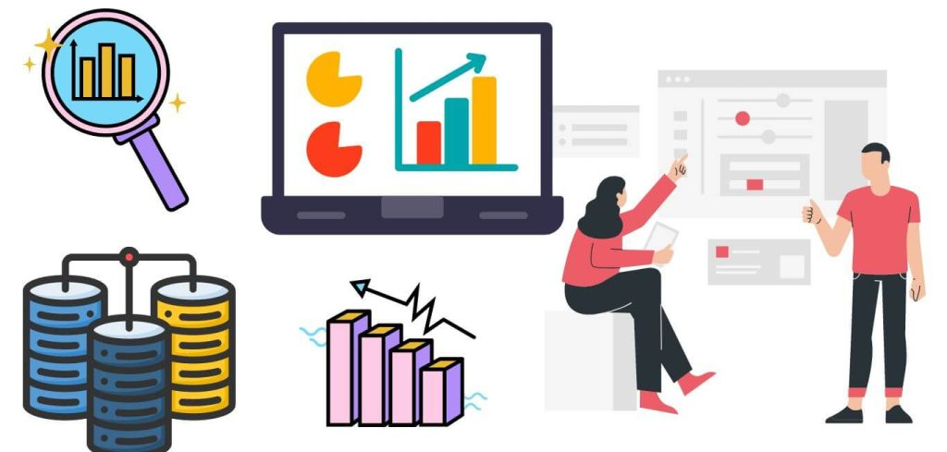
Descriptive Analysis

Slide 13
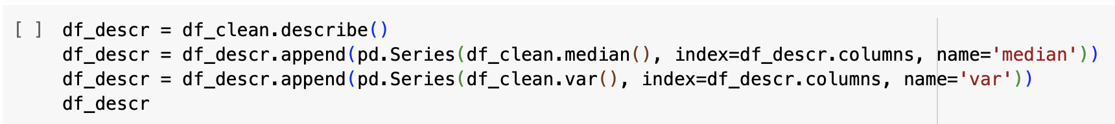
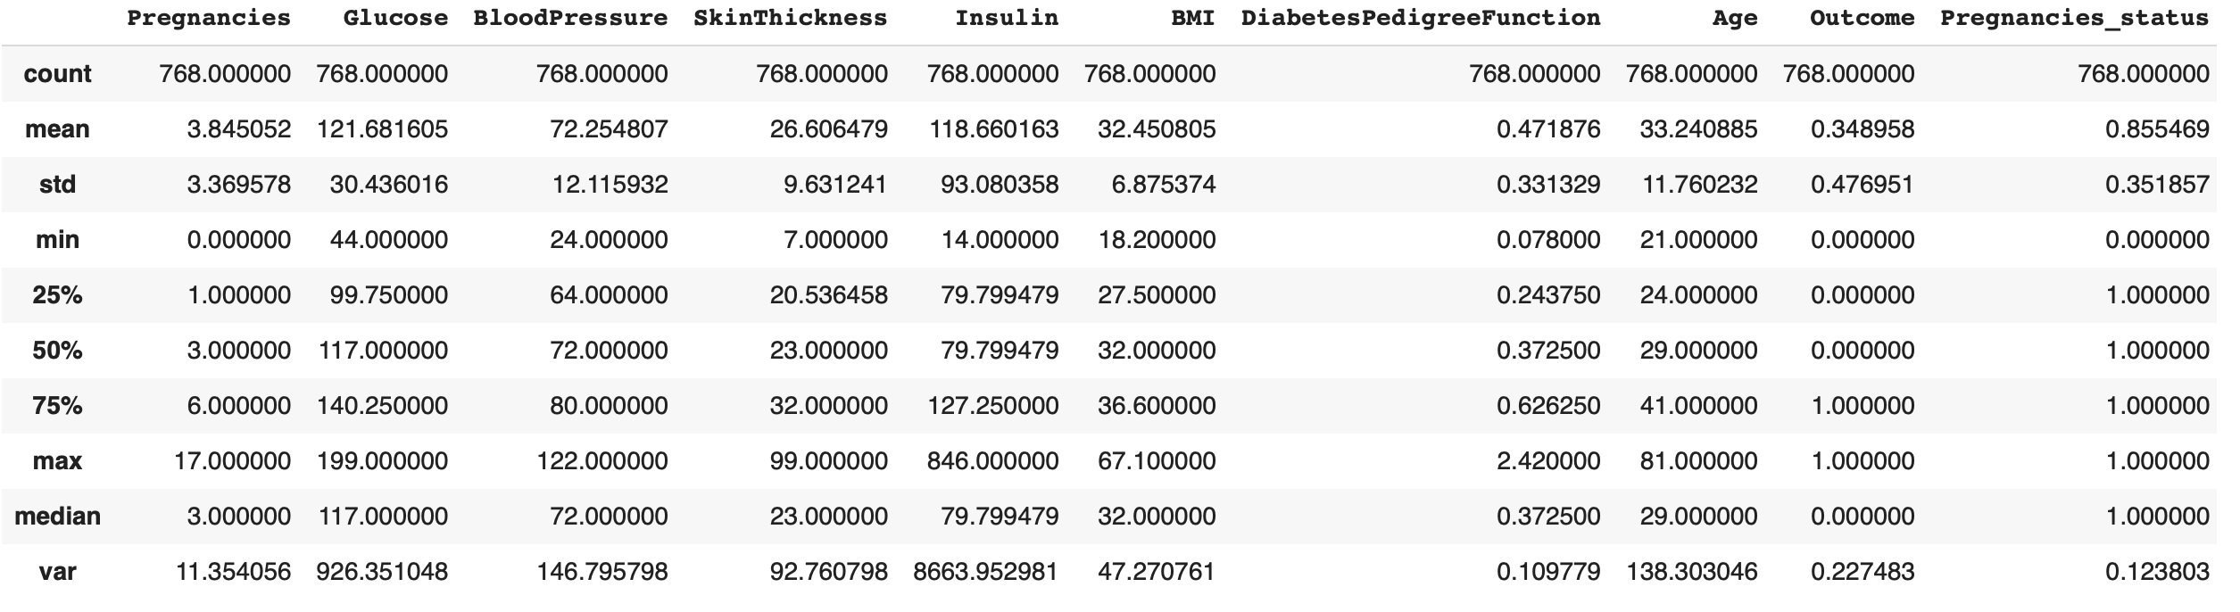
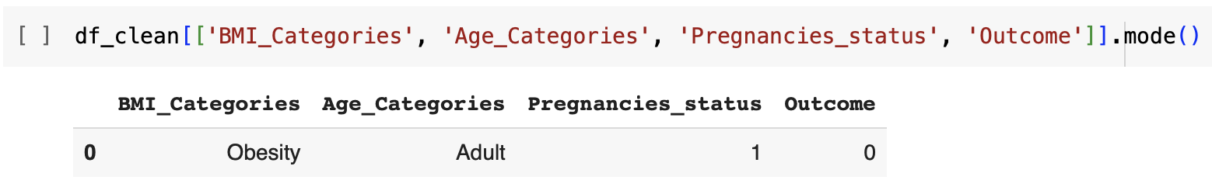
Descriptive Analysis:

Slide 14
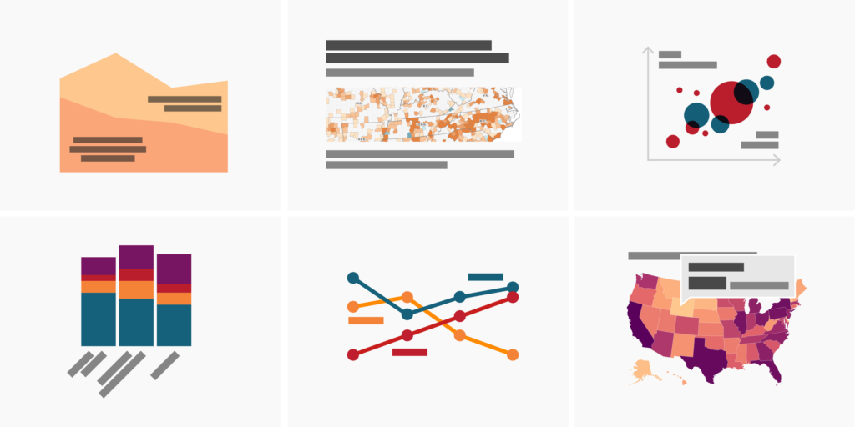
Data Visualization

Slide 15
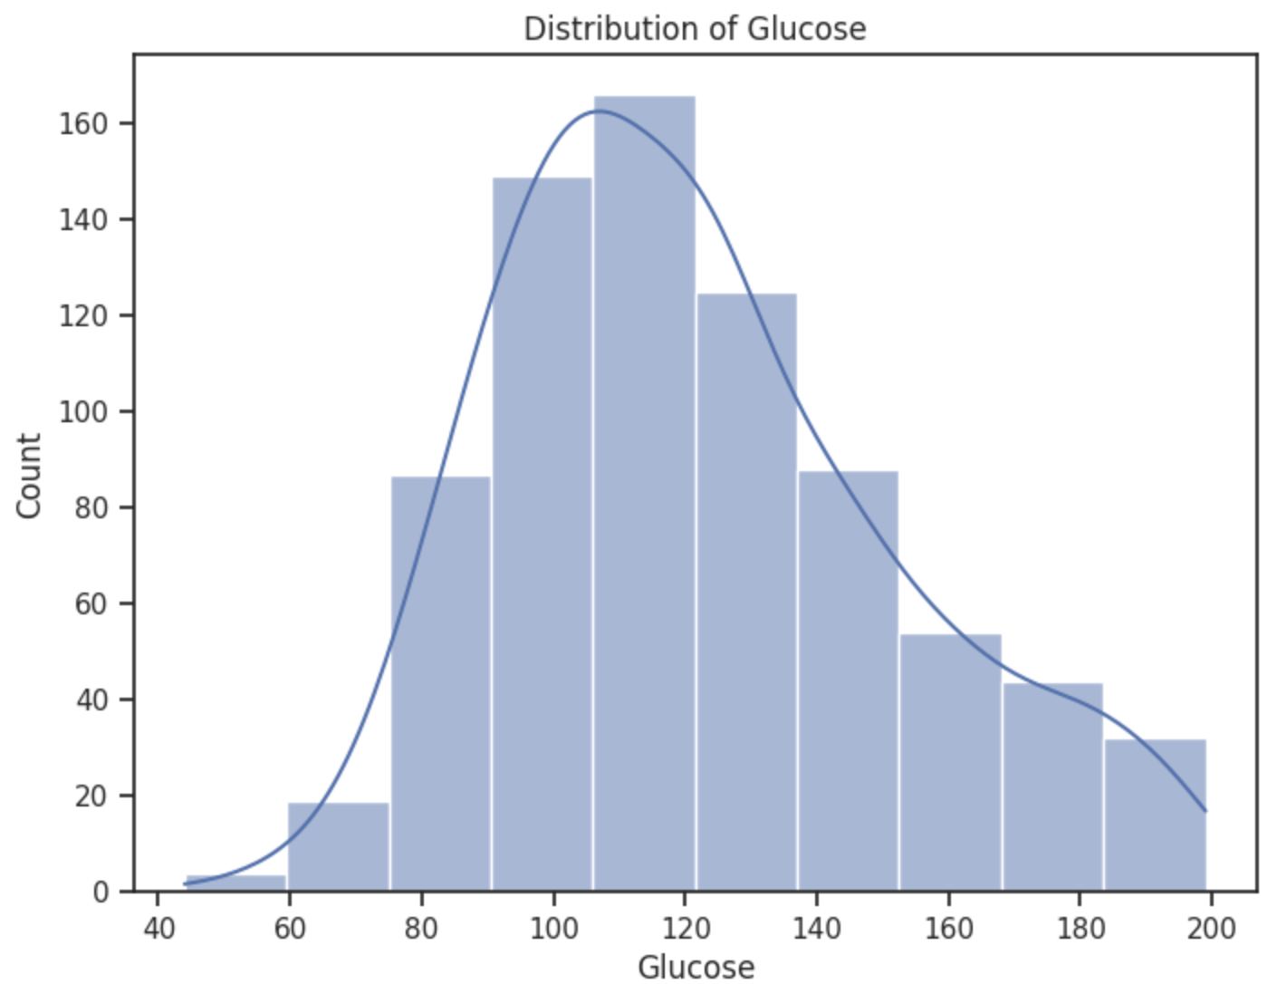
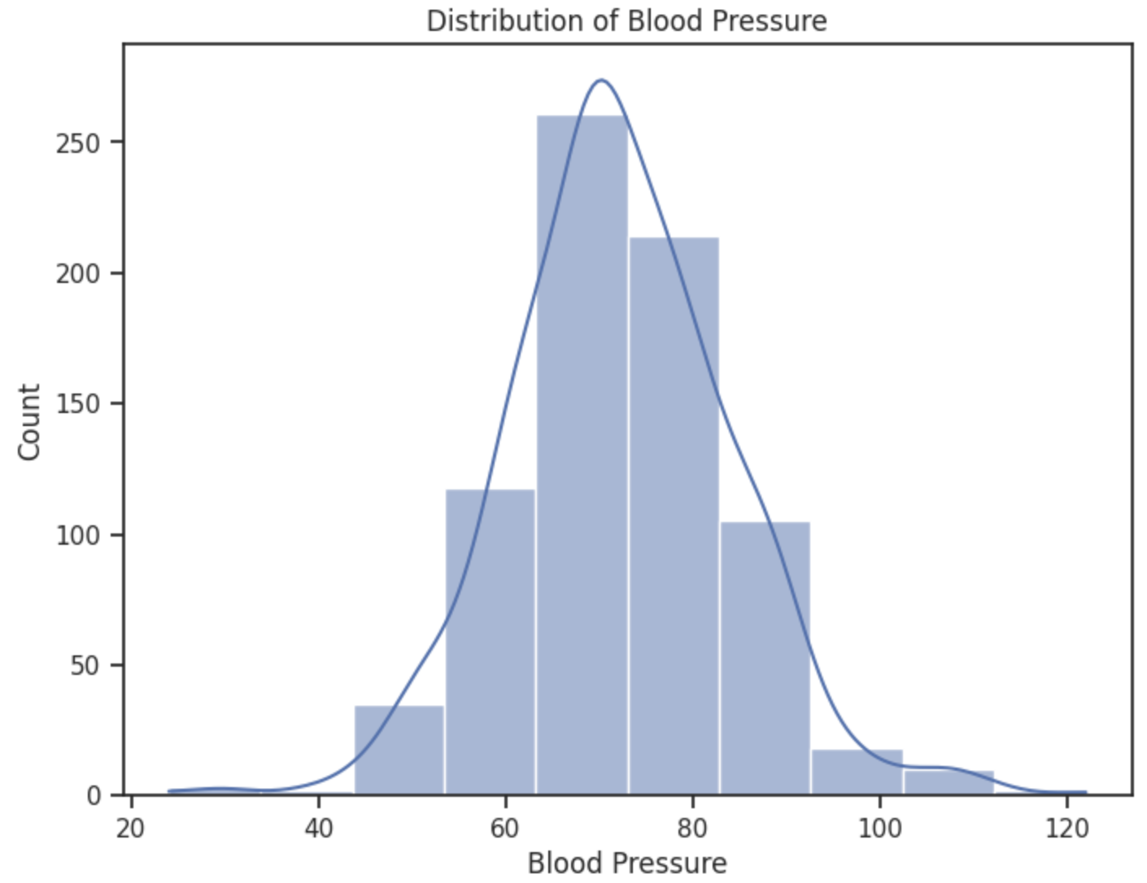
Data Visualization: Part 1: Distributions
The distribution of glucose levels exhibits characteristics of a symmetrical normal distribution with a concentration of values around the central range of 90 to 120.
The blood pressure distribution is approximately symmetrical and normal. The mean and median of the distribution are approximately equal, indicating a lack of significant skewness. More than half of the distribution falls within the range of 60 to 80.

Slide 16
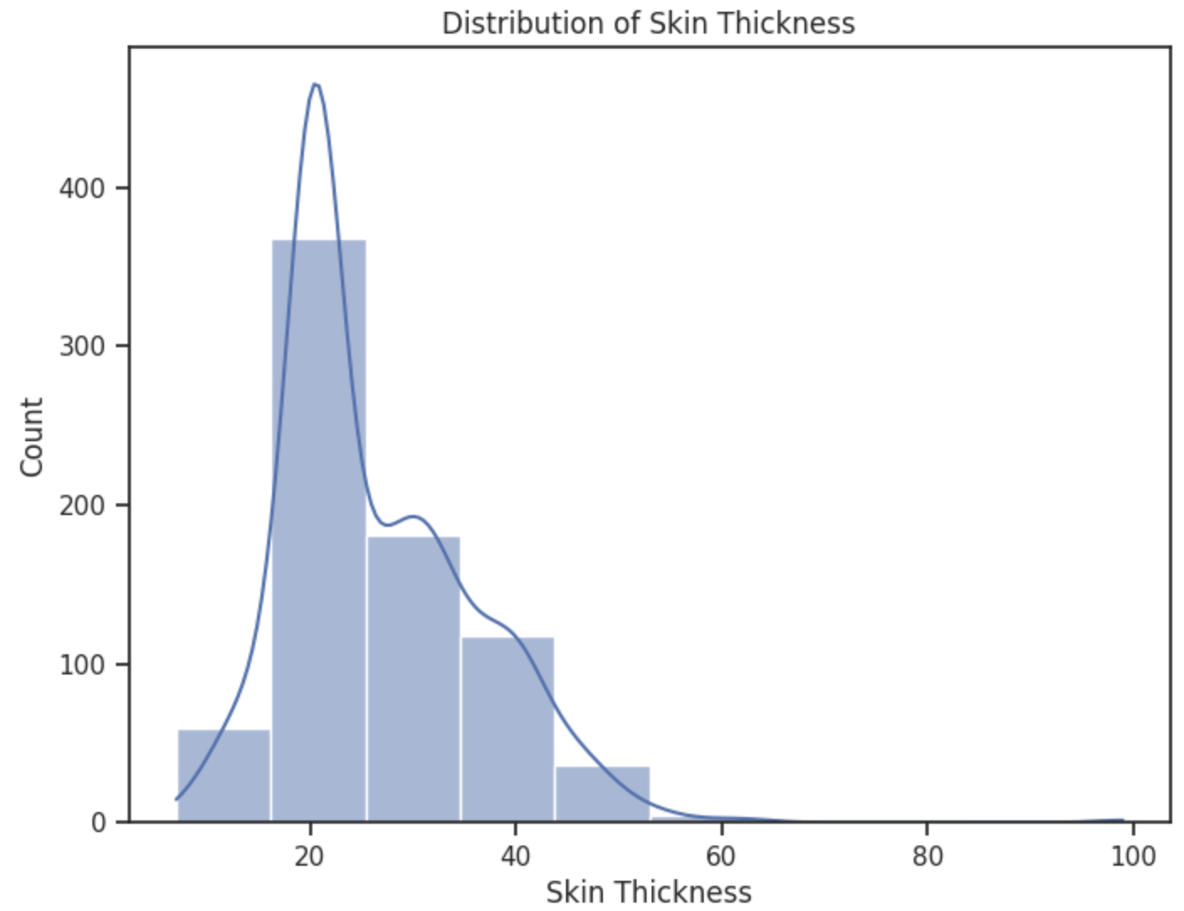
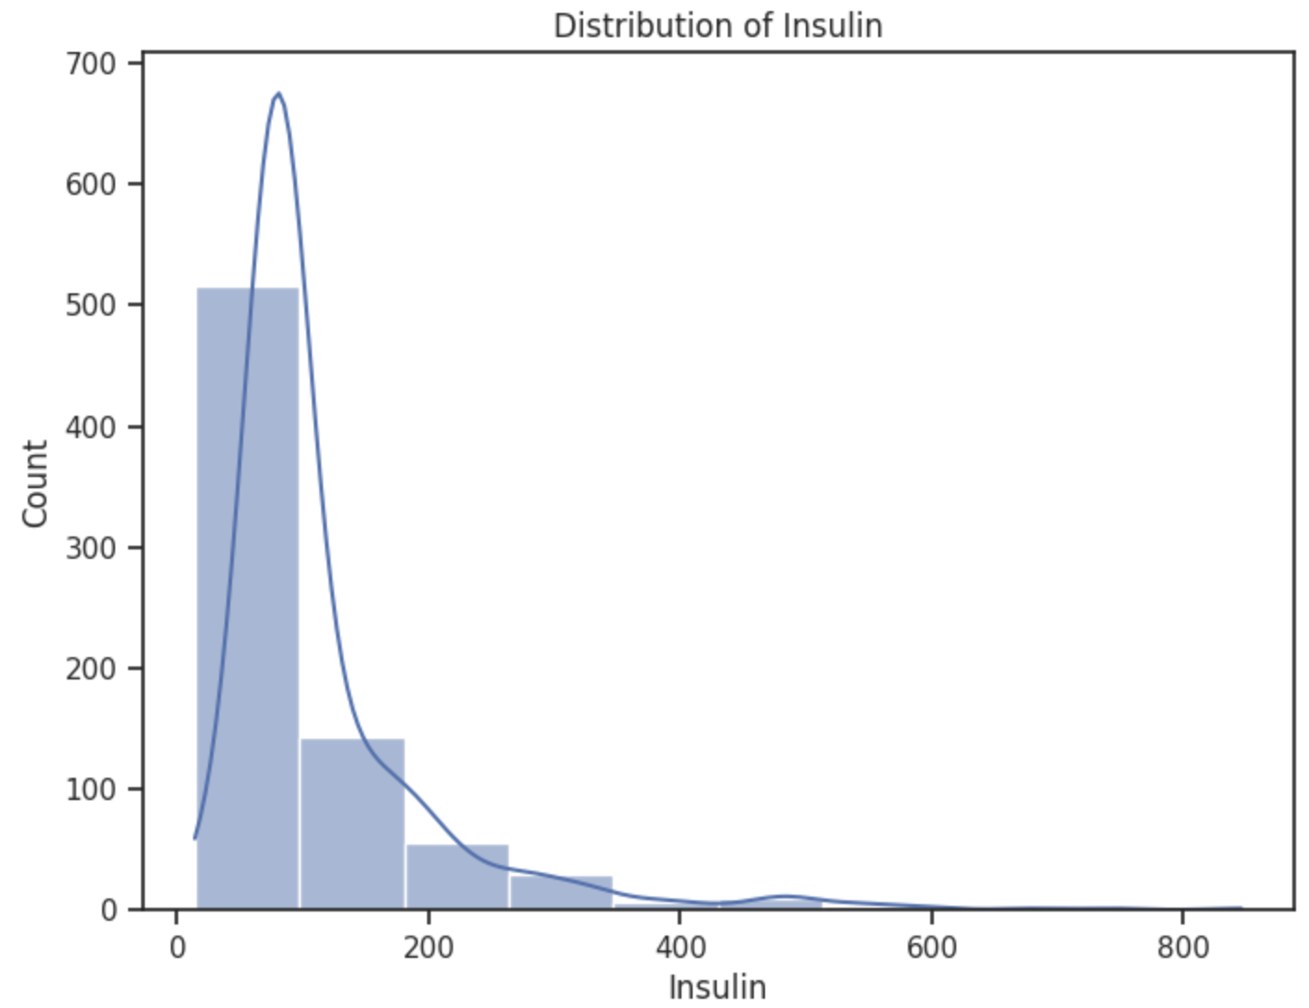
Data Visualization: Part 1: Distributions
Despite the close proximity between the mean and median values, the distribution is not considered normally distributed. This highlights the importance of visualizing the data to gain a better understanding of its underlying characteristics. The skin thickness distribution exhibits a slight positive skew.
Majority of individuals have lower insulin levels, with a long tail extending towards higher values.
More than 80% of individuals have insulin levels below 200. This suggests that the majority of the dataset falls within this range, indicating a concentration of lower insulin values.

Slide 17
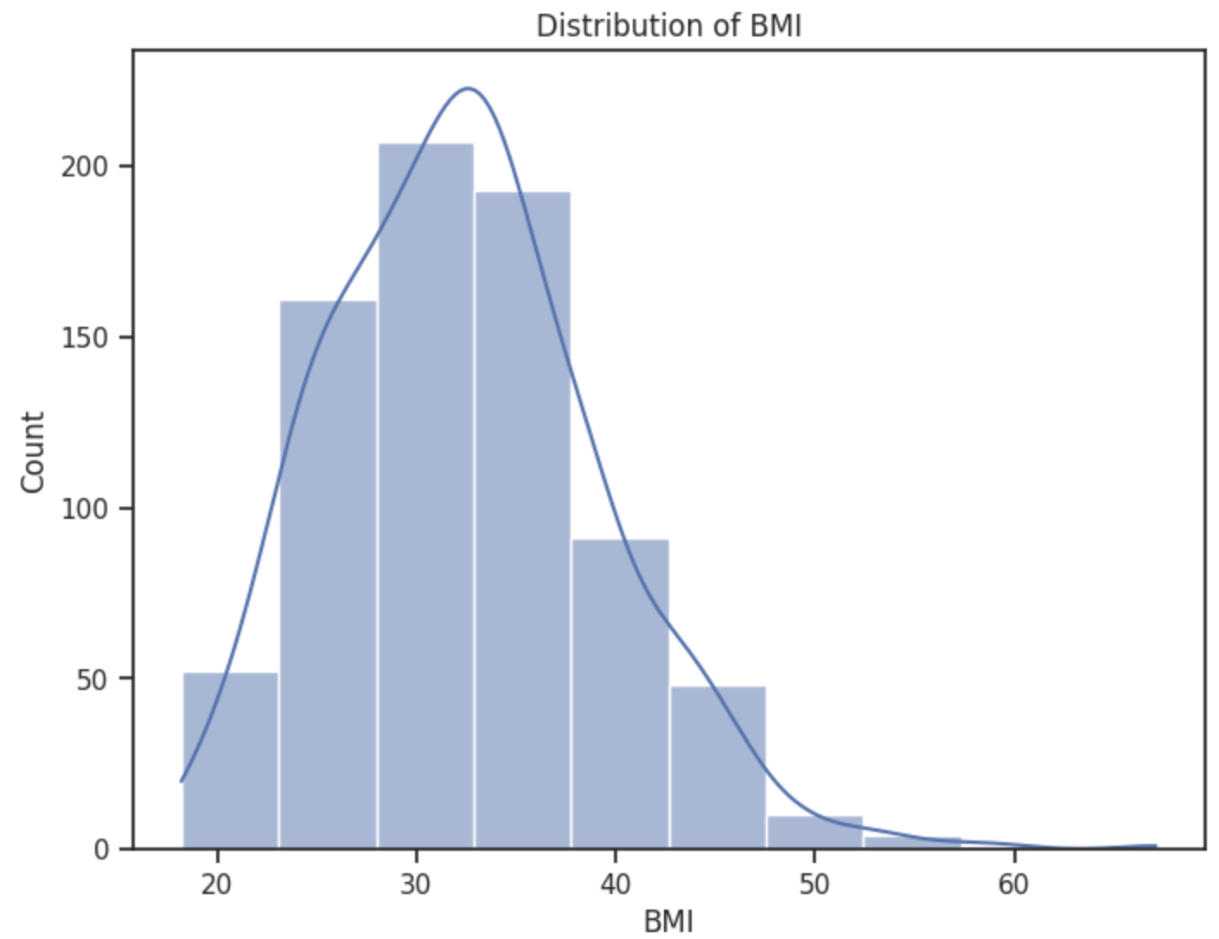
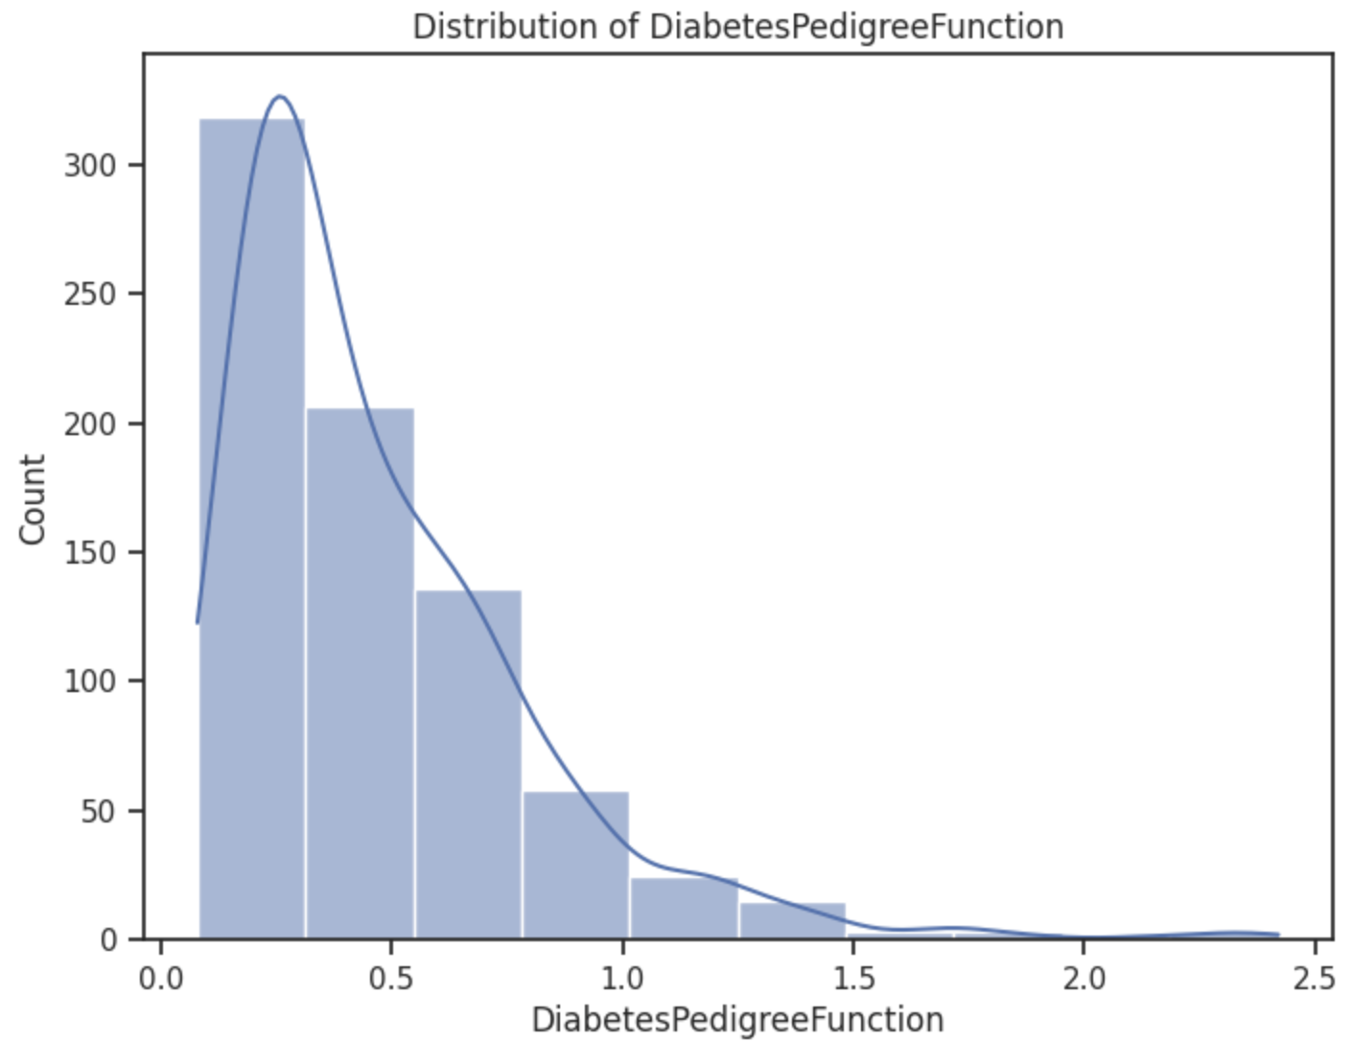
Data Visualization: Part 1: Distributions
The distribution appears to be nearly normally distributed. More than 50% of individuals fall within the range of 30 to 40 for their BMI values. Additionally, there may be only a small number of individuals with significantly high BMI values.
The pedigree function for pregnancy is highly right-skewed, indicating that the majority of individuals have lower values. There is a small number of people with pedigree function values between 1.5 and 2.5. Furthermore, the distribution is predominantly below 0.5.

Slide 18
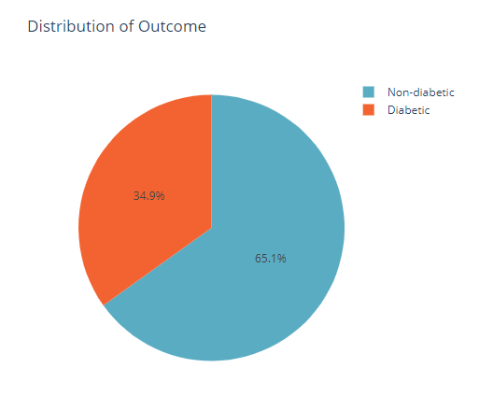
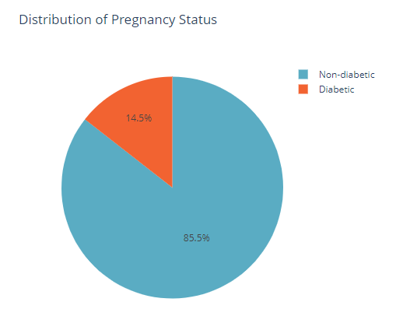
Data Visualization: Part 1: Distributions
The pie chart illustrating the distribution of outcomes reveals that approximately 65% of individuals are non-diabetic, while the remaining 35% have been diagnosed with diabetes.
In terms of pregnancy status, the pie chart indicates that 85% of the population has experienced pregnancy at least once.

Slide 19
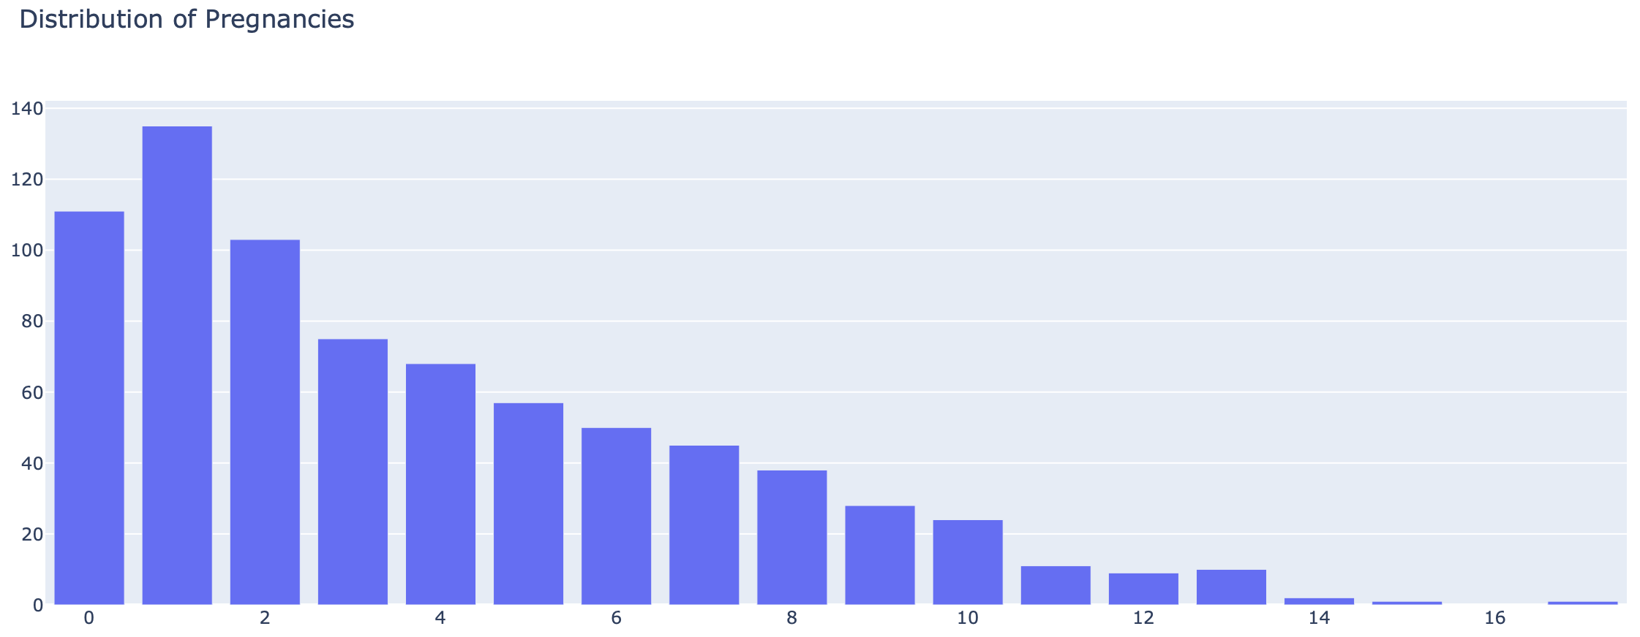
Data Visualization: Part 1: Distributions
The histogram representing the distribution of the number of pregnancies shows that roughly 50% of individuals have either not experienced pregnancy or have been pregnant no more than twice. The maximum number of pregnancies reported by an individual is 17.

Slide 20
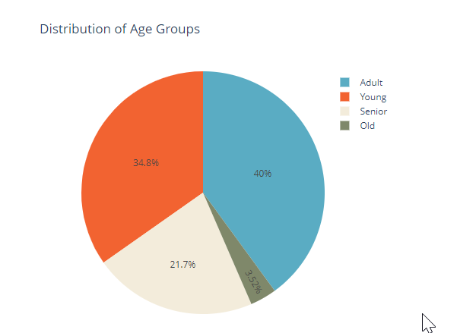
Data Visualization: Part 1: Distributions
The pie chart illustrates the distribution of age categories. Approximately three-quarters of the population falls under the age of 40. The group with the highest percentage is the adult category, representing 40% of the total population. On the other hand, the old age group, which includes individuals aged 60 years or older, has the lowest percentage at 3.5%.

Slide 21
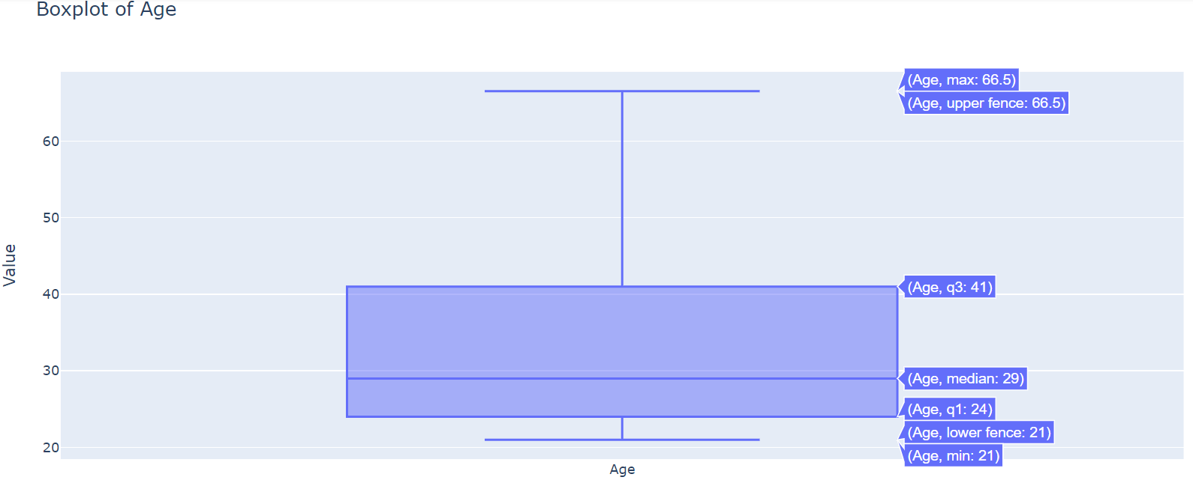
Data Visualization: Part 2: Individual Boxplots
The boxplot of the age distribution reveals that the median age is 29, indicating that half of the individuals fall below this age and half are above it. The interquartile range (IQR), representing the middle 50% of the data, spans from 24 to 41. This indicates that the majority of individuals in the dataset are within this age range.
The minimum age is 21, suggesting that there are individuals as young as 21 in the dataset. On the other hand, the maximum age is 81, indicating that there are individuals as old as 81. This wide range of ages demonstrates the diversity of age groups in the dataset.

Slide 22
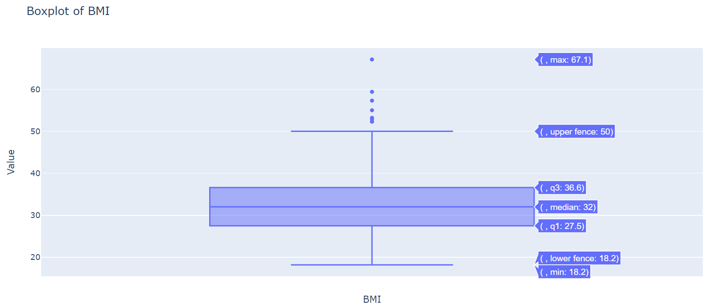
Data Visualization: Part 2: Individual Boxplots
The median BMI is 32, which means that half of the individuals have a BMI below this value and half have a BMI above it. The interquartile range (IQR), representing the range of the middle 50% of the data, spans from 27.5 to 36.6. This indicates that the majority of individuals in the dataset have BMI values within this range.
The minimum BMI recorded is 18.2, indicating the presence of under-weight individuals. On the other hand, the maximum BMI is 67.1, suggesting the existence of individuals with significantly higher BMI values.
While there are a few data points above the upper fence, which any be consider Ed outliers, overall, the boxplot still shows central tendence and spread, thus providing valuable insights into the characteristics of the dataset.

Slide 23
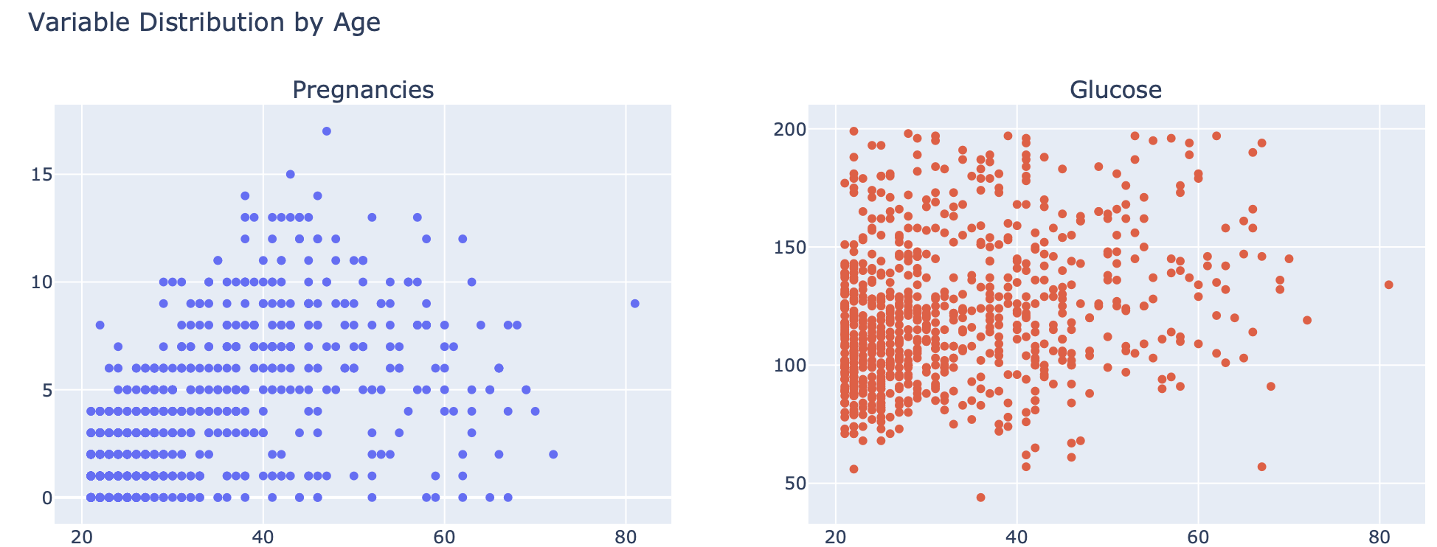
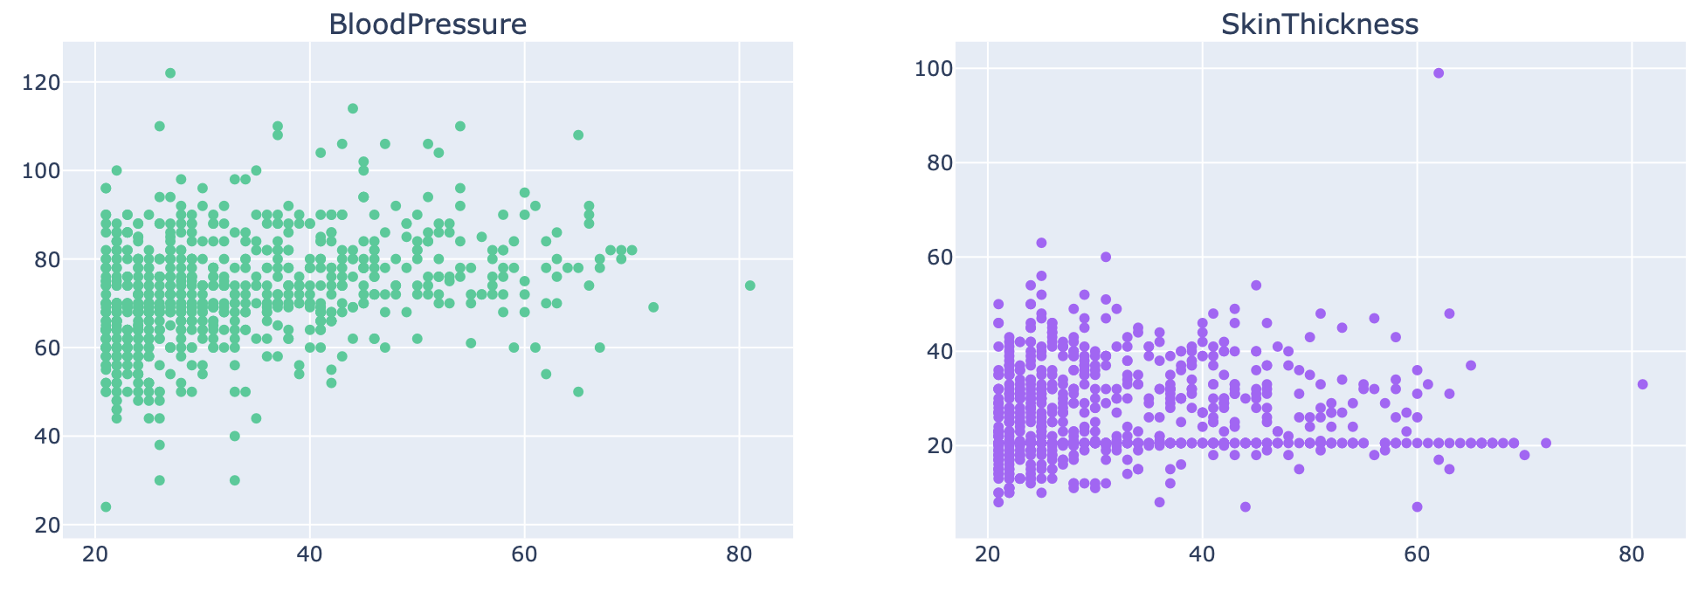
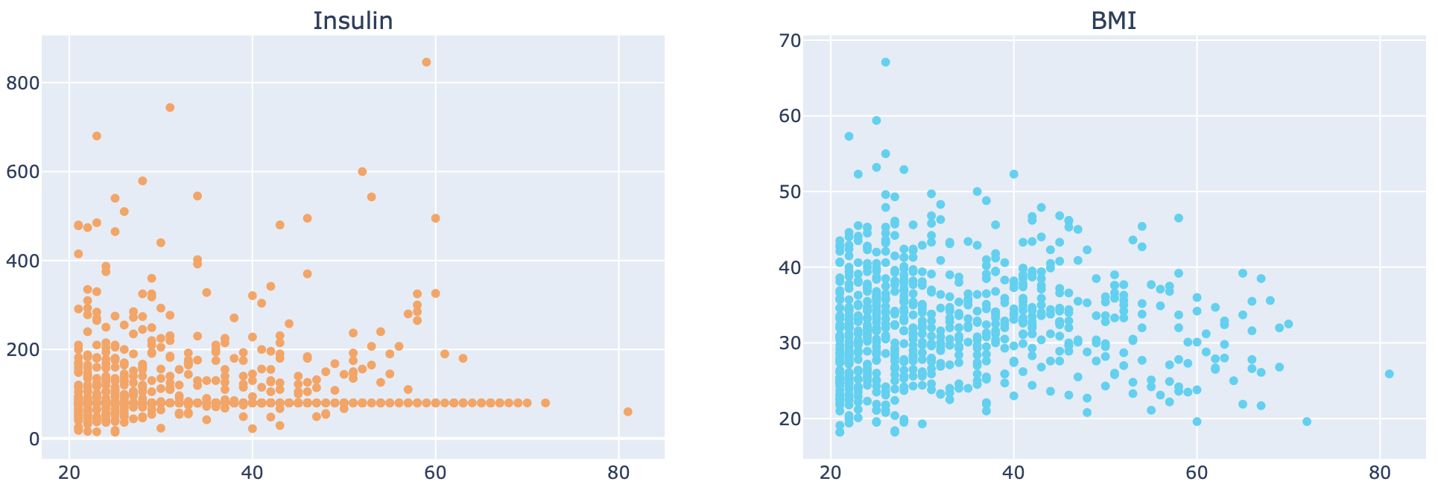
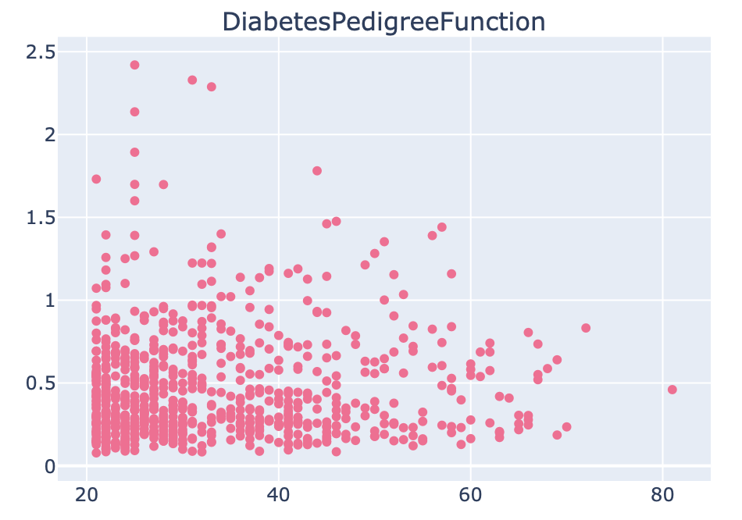
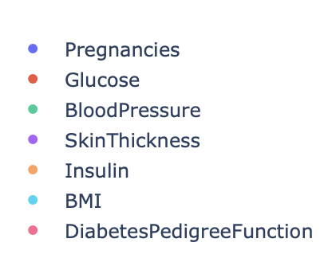
Data Visualization: Part 3: Variable combinations (by Age)
By examining these scatter plots, we can gain insights into how each variable relates to age and potentially identify any patterns or relationships that may exist within the dataset.

Slide 24
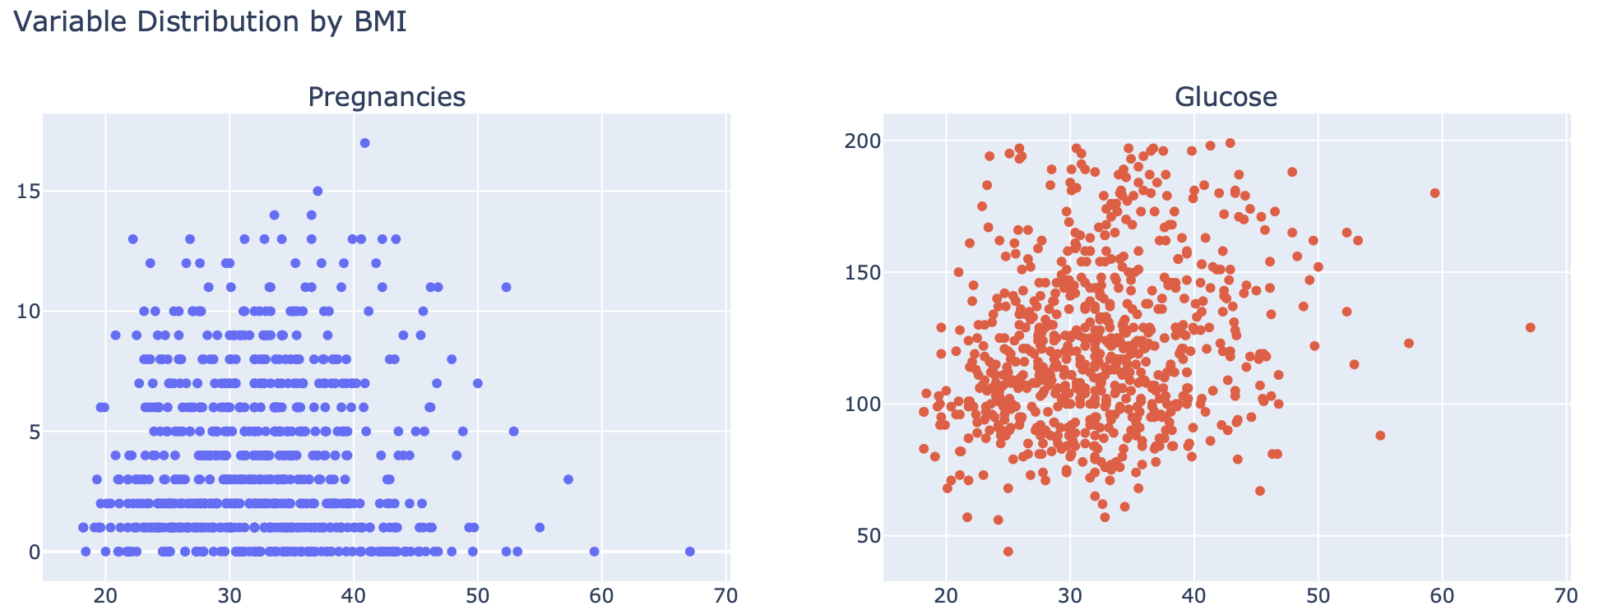
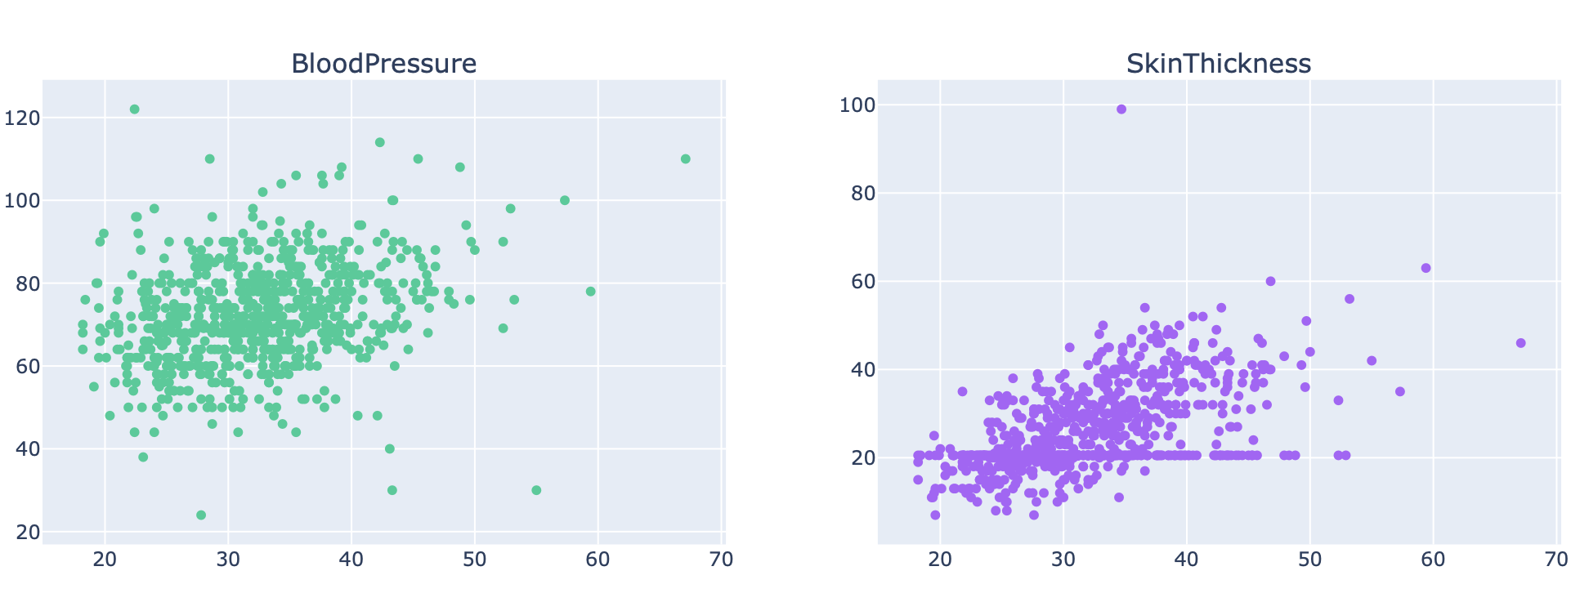
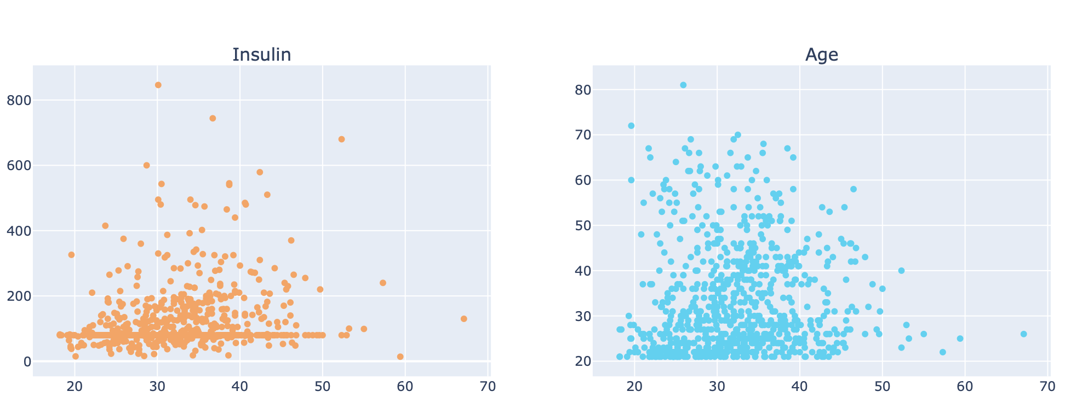
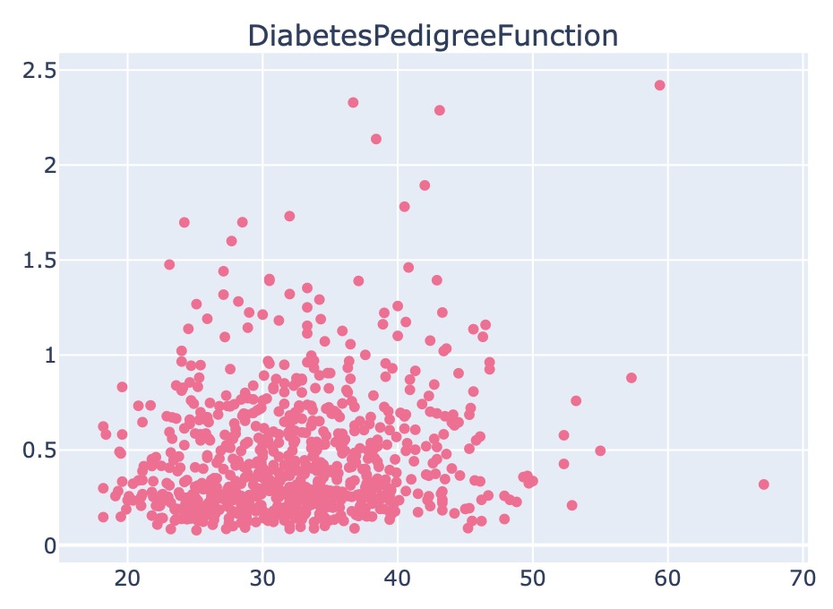
Data Visualization: Part 3: Variable combinations (by BMI)
By examining these scatter plots, we can gain insights into how each variable relates to BMI and potentially identify any patterns or relationships that may exist within the dataset.

Slide 25
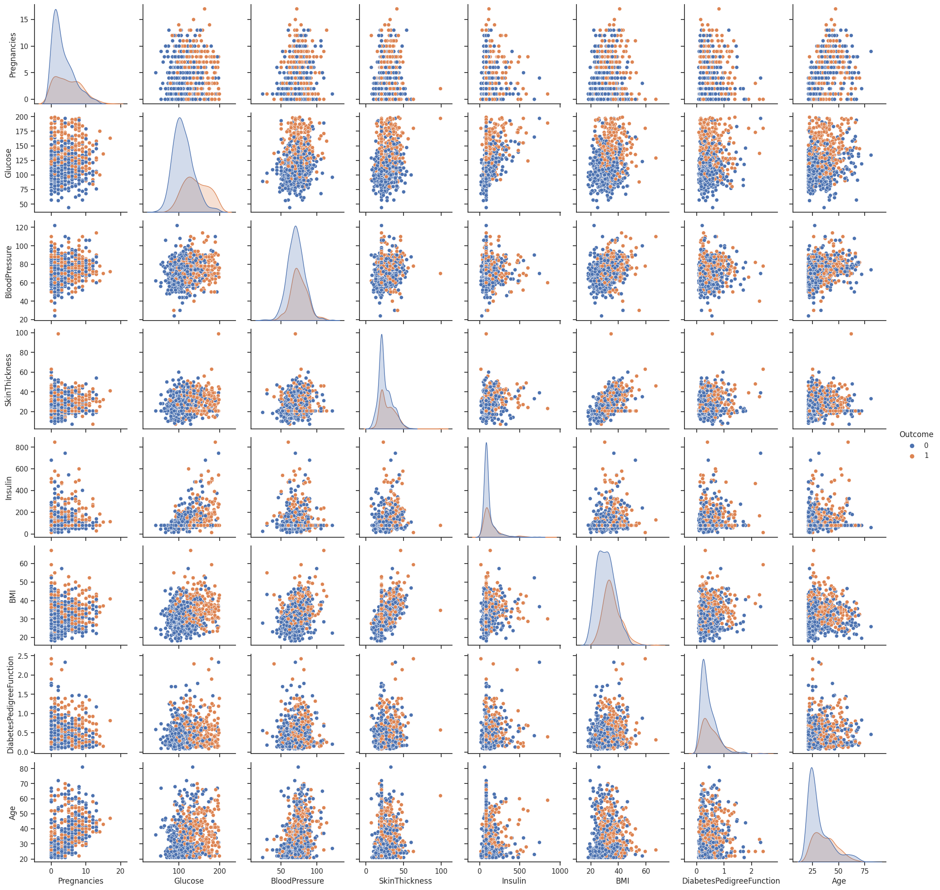
Data Visualization: Part 4: Pairplot
'Glucose' vs 'BMI': This plot shows the relationship between the blood glucose levels and body mass index. We can observe if there is any clustering or pattern between these two variables, and whether there is a difference in distribution for diabetic and non-diabetic individuals.
'Age' vs 'Insulin': This plot displays the relationship between age and insulin levels. It allows us to analyze if there are any trends or patterns in insulin levels as individuals age, and whether there is any difference between diabetics and non-diabetics.
'Pregnancies' vs 'DiabetesPedigreeFunction': This plot shows the relationship between the number of pregnancies and the diabetes pedigree function. It allows us to examine if there is any correlation between the two variables and whether the diabetes pedigree function differs for individuals with different pregnancy counts.
Overall, the pairplot provides a comprehensive overview of the relationships between the selected variables and their distributions in the dataset. It helps us identify potential correlations and patterns, and provides a visual representation of how the variables relate to each other in the context of diabetes prediction.

Slide 26
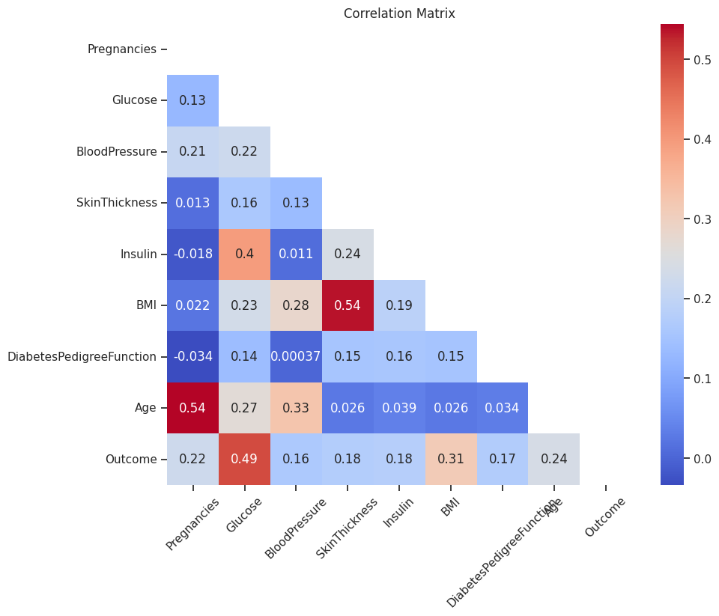
Data Visualization: Part 5: Correlation
The correlation matrix provides an overview of the relationships between different column headings. The maximum correlation coefficient observed is 0.54, which occurs between Age and Number of pregnancies. This correlation makes intuitive sense, as the number of pregnancies experienced by an individual may be influenced by their age.
Additionally, the correlation between BMI and skin thickness is notable, with a correlation coefficient of 0.54. This suggests a relationship between these two variables, indicating that individuals with higher BMI values may tend to have thicker skin.
Furthermore, the correlation coefficient of 0.4 between Insulin and Glucose indicates a moderate level of correlation between these variables. This suggests that there may be some association between insulin levels and glucose levels in the dataset.

Slide 27
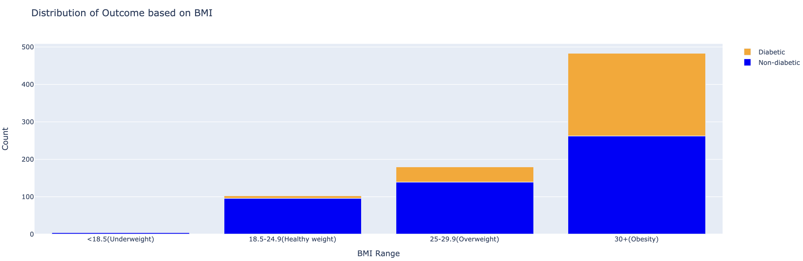
Data Visualization: Part 6: Bar plots
The bar plot illustrates the distribution of outcomes (diabetic and non-diabetic) based on body mass index (BMI) categories. The BMI categories include "Underweight" (<18.5), "Healthy weight" (18.5-24.9), "Overweight" (25-29.9), and "Obesity" (30+).
In the dataset, there are 4 individuals categorized as underweight, and none of them are diabetic. The healthy weight range consists of 95 non-diabetic individuals and a small count of 7 diabetic individuals.
For the overweight range, there are 139 non-diabetic individuals and 40 diabetic individuals. However, the highest count of diabetic patients is observed in the "Obesity" category (BMI 30+), with 221 individuals, along with the highest count of non-diabetic patients (262). It is noteworthy that individuals with a BMI of 30+ make up a significant proportion of the studied population.
These findings highlight the association between BMI categories and the prevalence of diabetes, with the highest risk observed in the obesity category.

Slide 28
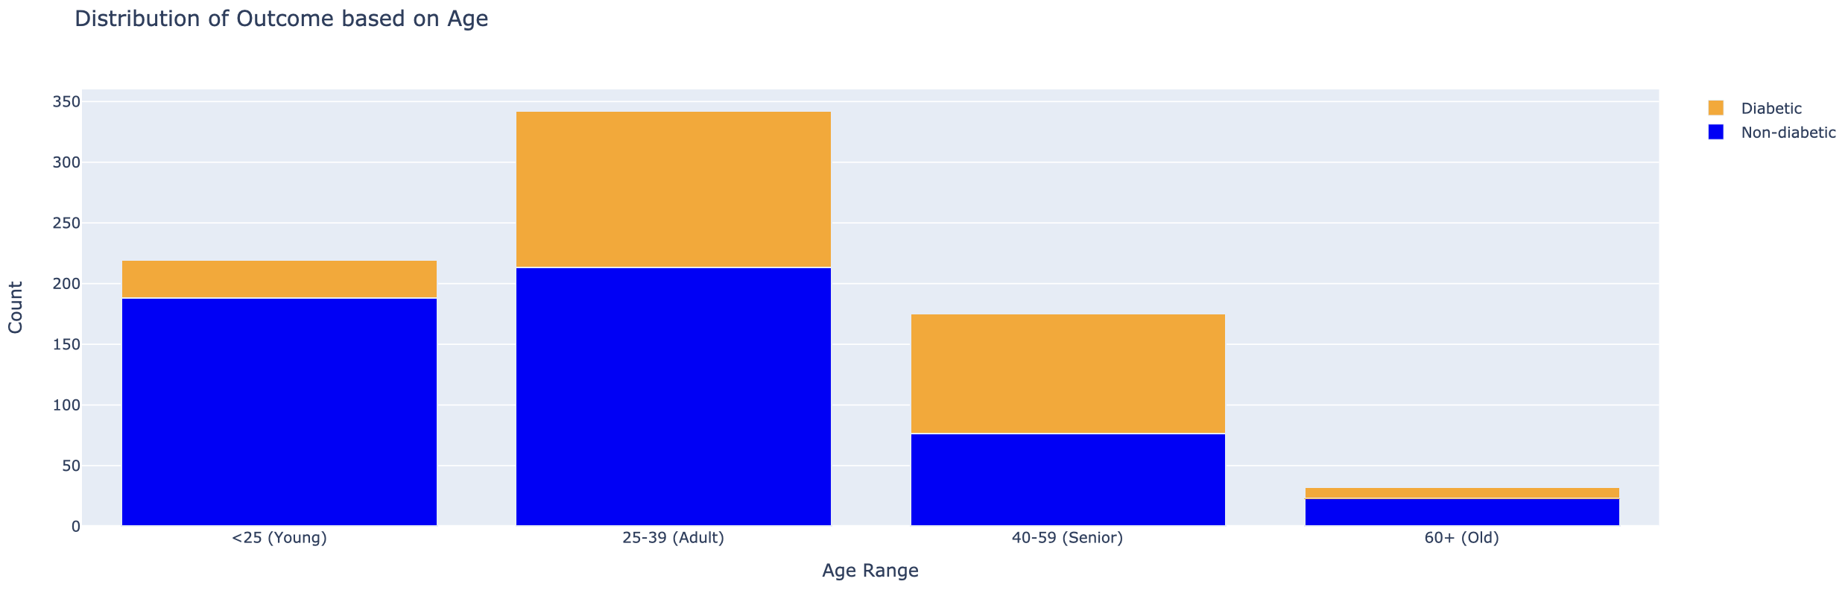
Data Visualization: Part 7: Bar plots
The bar plot represents the distribution of outcomes (diabetic and non-diabetic) based on different age ranges. The age ranges are categorized as "Young" (<25 years old), "Adult" (25-39 years old), "Senior" (40-59 years old), and "Old" (60+ years old).
In the dataset, the "Young" age range (less than 25 years old) has a total of 188 non-diabetic individuals and 31 diabetic individuals. This suggests that a larger proportion of individuals in this age range are non-diabetic.
The "Adult" age range (25-39 years old) shows a higher count of diabetics with 129 individuals, while 213 individuals in this age range are non-diabetic. This indicates that the prevalence of diabetes is relatively higher in the adult age group compared to the young age group.
Moving on to the "Senior" age range (40-59 years old), there are 99 individuals classified as diabetics and 76 individuals classified as non-diabetics. This suggests a relatively higher prevalence of diabetes in the senior age group compared to the non-diabetic population.
Finally, in the "Old" age range (60+ years old), there are 9 individuals classified as diabetics and 23 individuals classified as non-diabetics. This age range has a smaller sample size, indicating a lower prevalence of diabetes compared to the non-diabetic population.
Overall, the bar plot provides a visual representation of the distribution of outcomes across different age ranges. It allows us to observe the varying prevalence of diabetes among different age groups, with the highest count in the adult age range and relatively lower counts in the other age groups.

Slide 29
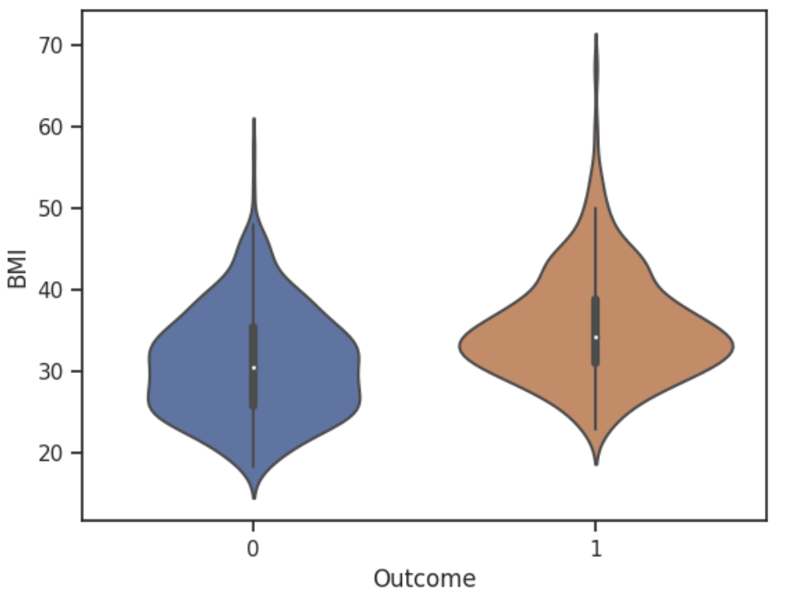
Data Visualization: Part 7: Violin plots
The violin plots effectively depict the differences between the BMI distributions of diabetic and non-diabetic individuals.
Median Comparison: The median of the diabetic group is visibly higher than the median of the non-diabetic group. This indicates that, on average, diabetic individuals tend to have higher BMI values in the variable being visualized
Whisker Comparison: The whiskers, representing the extent of the distribution, tend to be longer or wider in the diabetic group compared to the non-diabetic group. This suggests a greater range or variability in the variable among diabetic individuals.
Probability Density: The width or extension of the violin plot around the interquartile range (IQR) is indicative of the probability density. In the case of the diabetic group, the wider section around the IQR suggests a higher probability or concentration of individuals within that range.

Slide 30
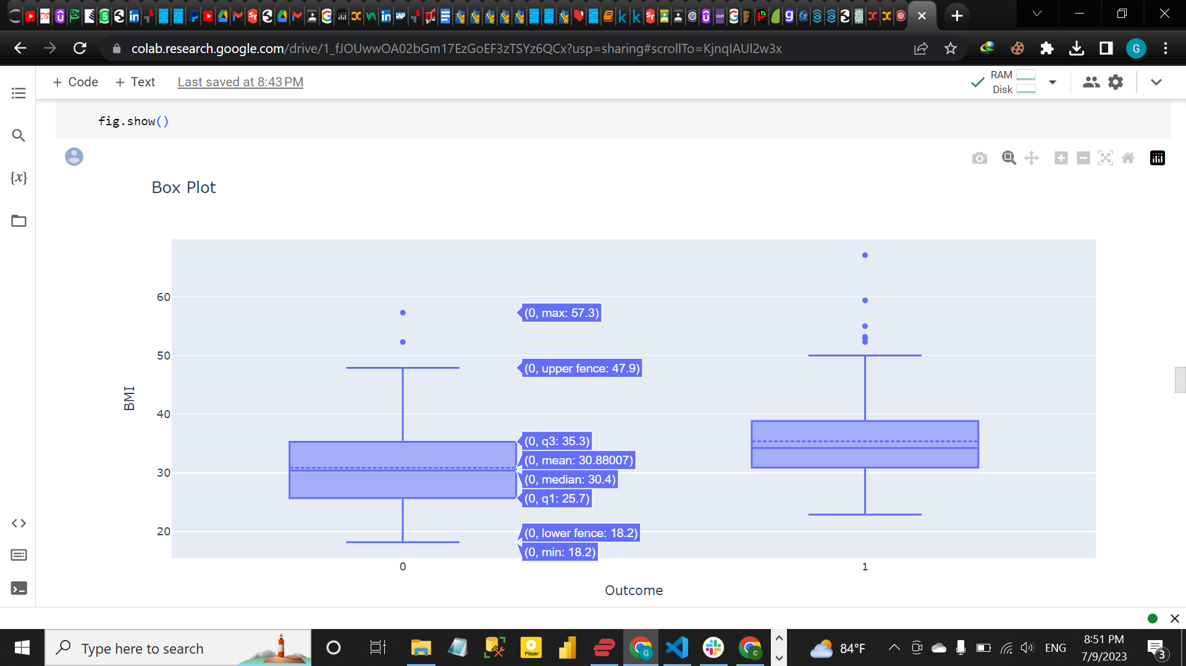
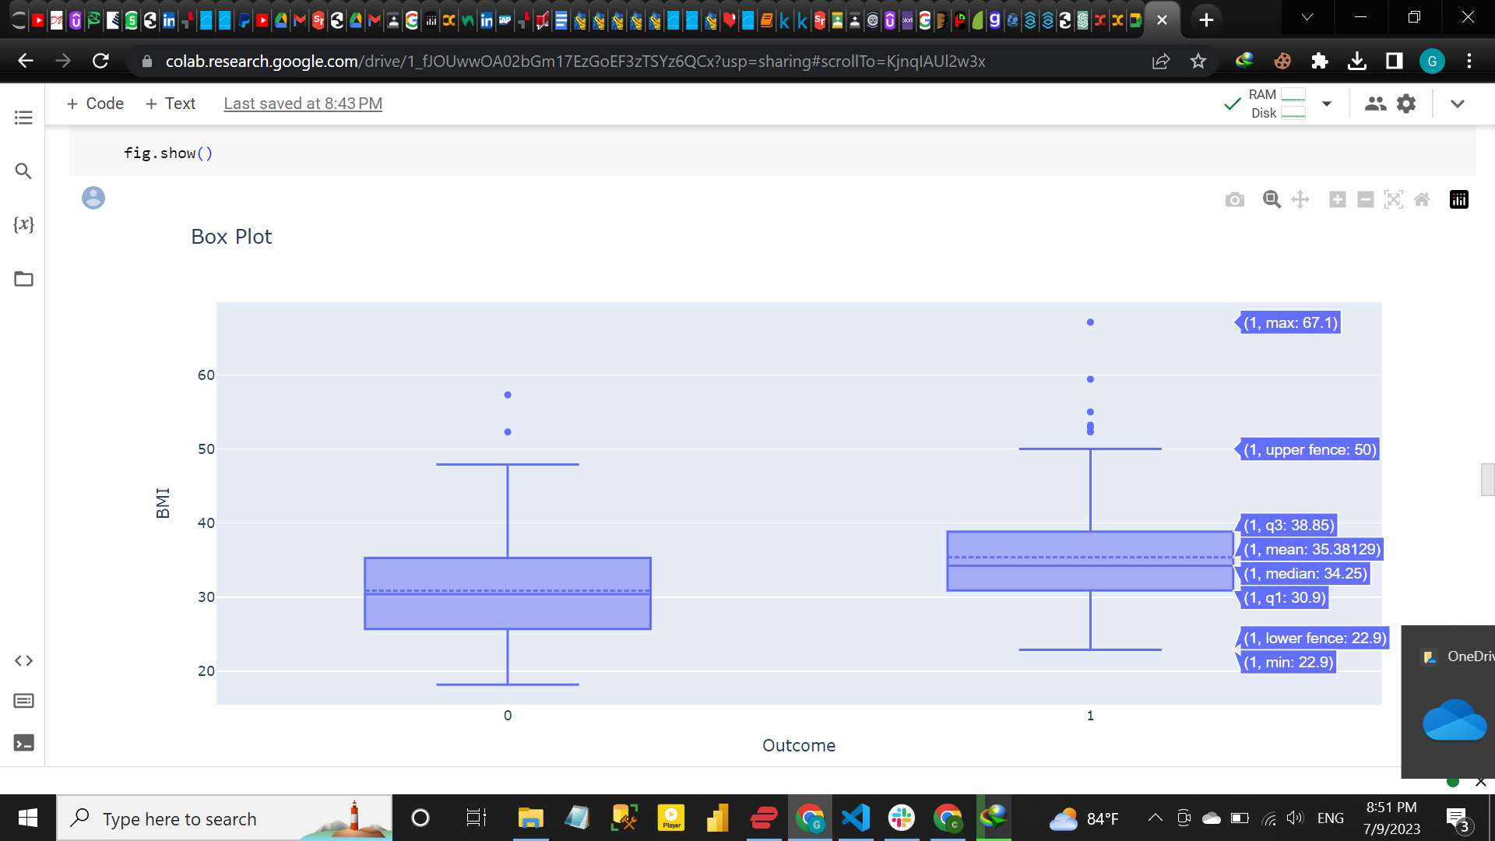
Data Visualization: Part 8: Variable Combinations (Boxplots)
The box plot comparison of BMI between diabetic and non-diabetic individuals reveals interesting findings. In terms of the minimum BMI value, it is observed that non-diabetic individuals tend to have lower BMIs compared to their diabetic counterparts. On the other hand, when considering the maximum BMI value, it is typically higher among the diabetic group.
The distribution of BMI in both groups are approximately in equal proportions.

Slide 31
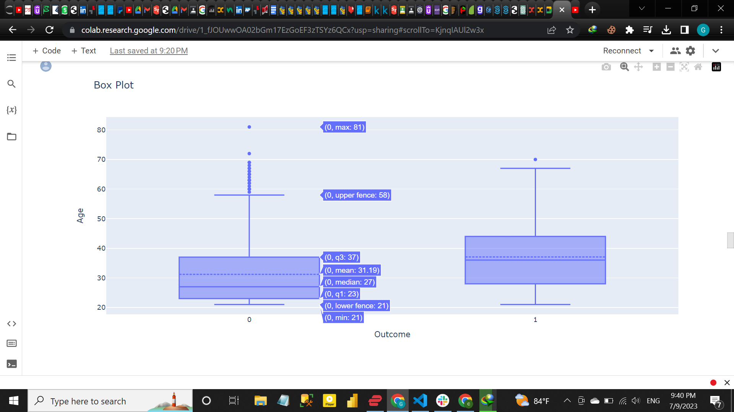
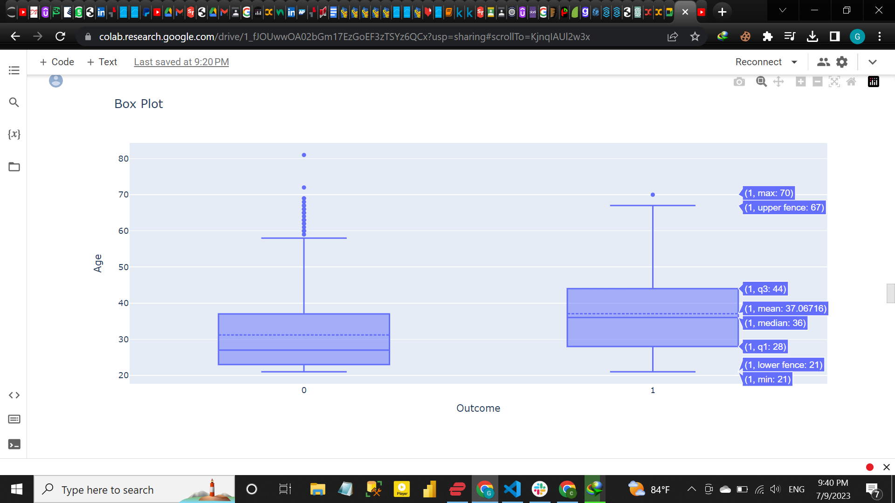
Data Visualization: Part 8: Variable Combinations (Boxplots)
From the box plot comparison of age between diabetic and non-diabetic individuals, several observations can be made. Based on these observations, we can infer that non-diabetic individuals, on average, tend to be younger than those diagnosed with diabetes. The higher median age in the diabetic group suggests that diabetes may be more prevalent or diagnosed at a later stage in life. The disparity between the mean and median ages in the non-diabetic group indicates a potential presence of outliers or a skewed distribution of age values. However, both groups have a similar spread of ages within their interquartile range (IQR).

Slide 32
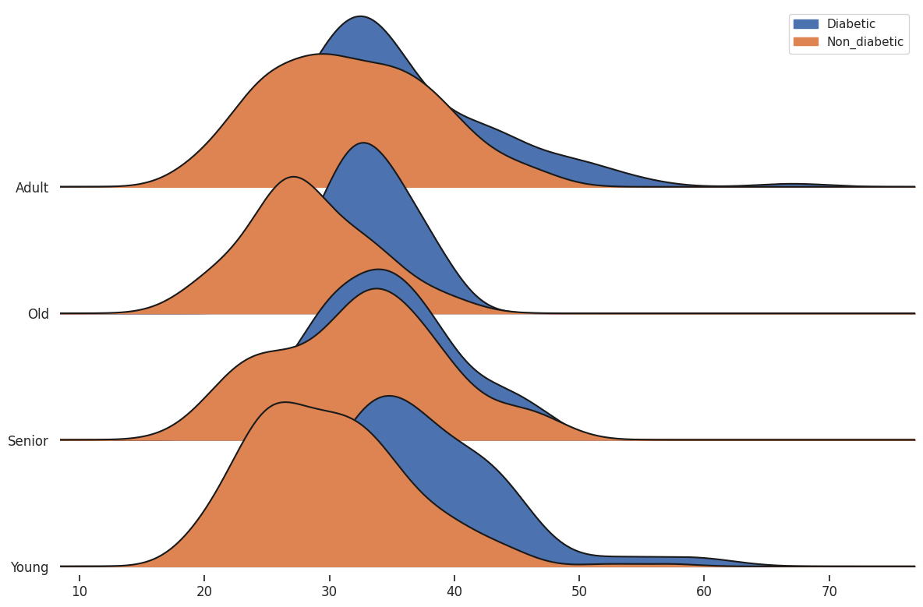
Data Visualization: Part 9: Variable Combinations (BMI Distribution/Age)
The plots depicting the distribution of BMI across different age categories consistently reveal a notable trend: non-diabetic individuals consistently exhibit lower BMI values compared to diabetic individuals across all age groups.
This observation suggests a consistent association between diabetes status and BMI, regardless of age. The plots clearly demonstrate that, within each age category, the BMI distribution for non-diabetic individuals tends to be shifted towards lower values, while the BMI distribution for diabetic individuals moves towards higher values.
In summary, the plots provide compelling evidence supporting the notion that non-diabetic individuals generally maintain lower BMI values compared to diabetic individuals, regardless of their age.

Slide 33

Data Visualization: Part 9: Variable Combinations (BMI Distribution/Age)
The plot shows a Kernel Density Estimation (KDE) plot which is used to estimate and visualize the probability density function (PDF) of the "Age" variable within each BMI category.
Based on the KDE plot, the highest probability density is observed for individuals between the ages of 12 and 35 in the underweight BMI category. This suggests that within this age range, there is a higher likelihood of individuals being classified as underweight compared to other BMI categories.
On the other hand, for the categories of obese, overweight, and healthy weight, the KDE plot indicates that the likelihood or probability of individuals falling into these BMI categories remains relatively consistent across the age spectrum. This suggests that the distribution of ages within these BMI categories is similar, without any notable concentration or deviation across different age groups.

Slide 34

Outliers

Slide 35


Dealing with Outliers - Winsorization

Slide 36

Statistical Analysis

Slide 37


Statistical Analysis:

Slide 38



Statistical Analysis: Hypotheses Testing 1

Slide 39


Statistical Analysis: Hypotheses Testing 2

Slide 40


Statistical Analysis: Hypotheses Testing 3

Slide 41


Statistical Analysis: Hypotheses Testing 4

Slide 42


Statistical Analysis: Hypotheses Testing 5

Slide 43


Statistical Analysis: Hypotheses Testing 6

Slide 44

Classification Algorithms

Slide 45




Classification: part 1: KNN

Slide 46




Classification: part 2: Decision Tree

Slide 47


Classification: part 2: Decision Tree

Slide 48





Classification: part 3: Regression Analysis

Slide 49


Classification: part 4: Comparing prediction models

Slide 50
Conclusion
The analysis relies on a dataset that describes various health characteristics of Native Indian females aged +21, specifically focusing on their health conditions categorized as either diabetic or non-diabetic.
We used data cleaning to replace zero values, added 3 qualitative columns based on the numeric columns, and replaced outliers using winsorisation technique.
A lot of data visualization techniques were used to investigate variables character and relationships between variables.
Using correlation analysis, we found that three variables most correlated with the diabetic status, are BMI, glucose level and age.
Using statistical analysis, we confirmed 5 hypotheses out of 6. Overall, diabetes is more common in patients with obesity, in senior patients, and in patients with glucose level, insulin level or both above average.
We used three classification models to predict diabetic status: KNN, Decision Tree, and Logistic Regression.
Logistic Regression has the highest precision, recall and f1-score, so this model was selected as the best one for predicting diabetic status.

Slide 51

Thanks a lot!

